Slide 1
TRIO Analysis of Subthalamic Nucleus Afferent Connectivity
Lucas Wang, Nicholas Foster, Hongwei Dong
Dong Lab at the UCLA David Geffen School of Medicine
Neuroscience Scholar Program Summer 2023

Slide 2
Table of contents
01
04
02
05
03
06
Background
Discussion
Methods
References
Results
Acknowledgements

Slide 3
01
Background

Slide 4
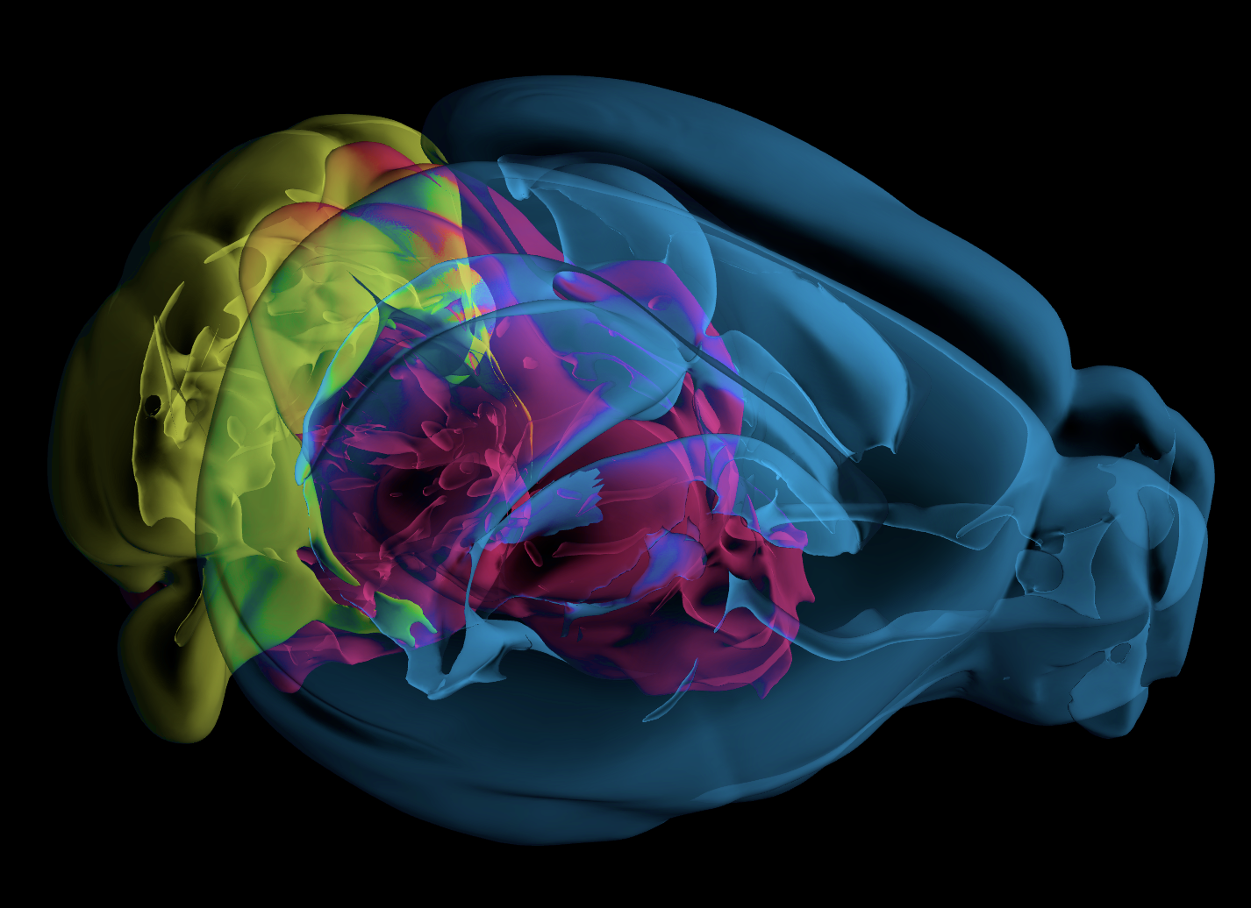
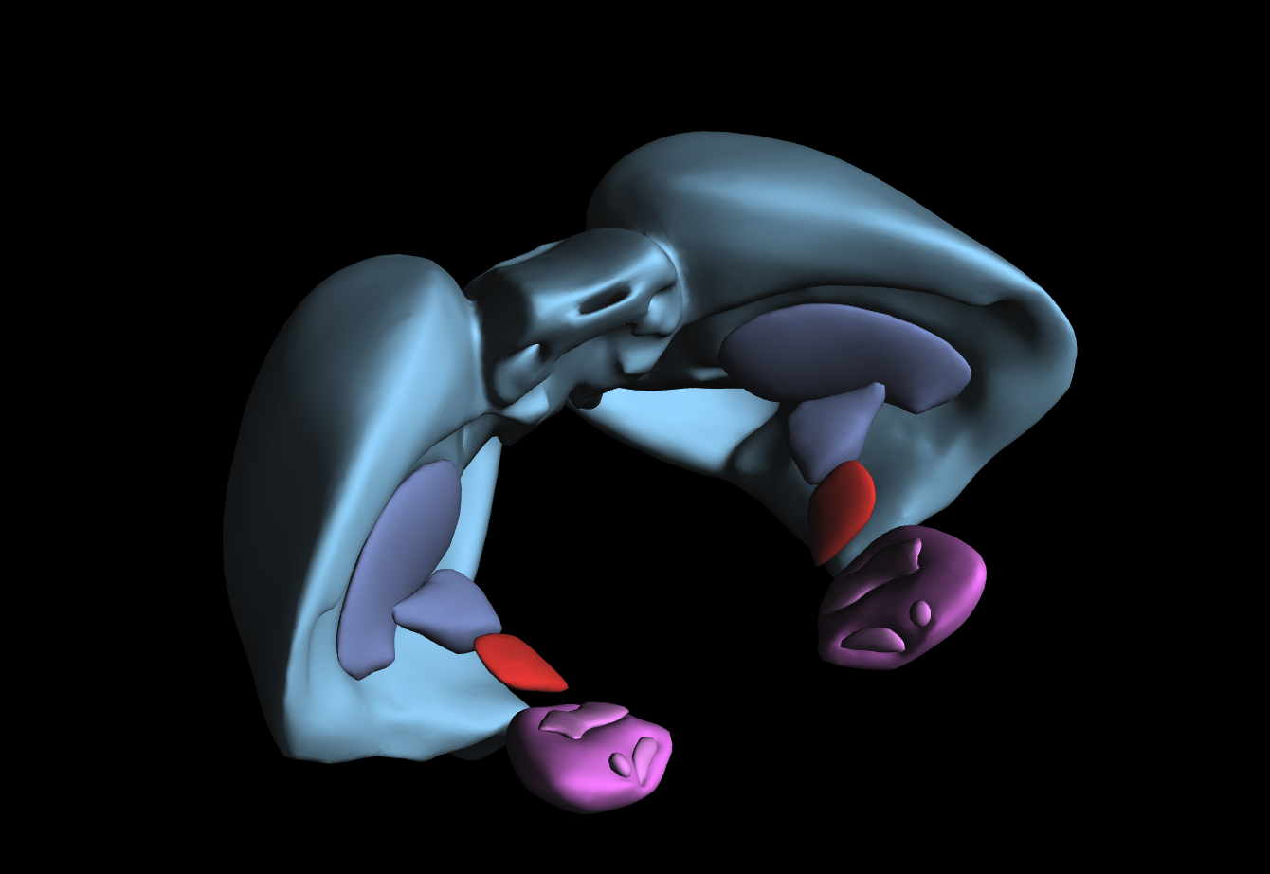
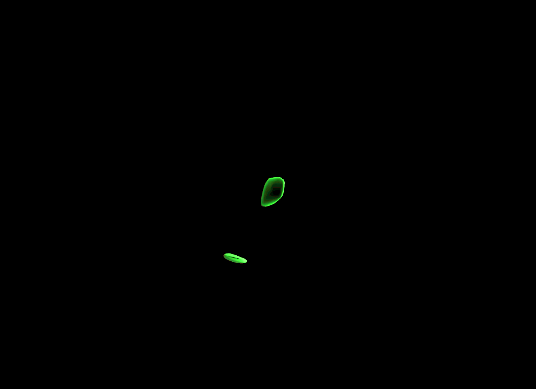
Subthalamic Nucleus (STN) is the Main Modulator of Basal Ganglia Output
The basal ganglia are involved in a complex collection of functions including motor control, reinforcement learning, and emotional control.
The subthalamic nucleus, as a component of the basal ganglia, sends extensive connections to the other nuclei and is considered the major modulator of Basal Ganglia output (Temel et al.).

Slide 5
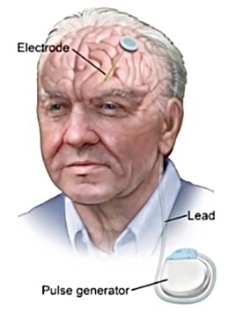
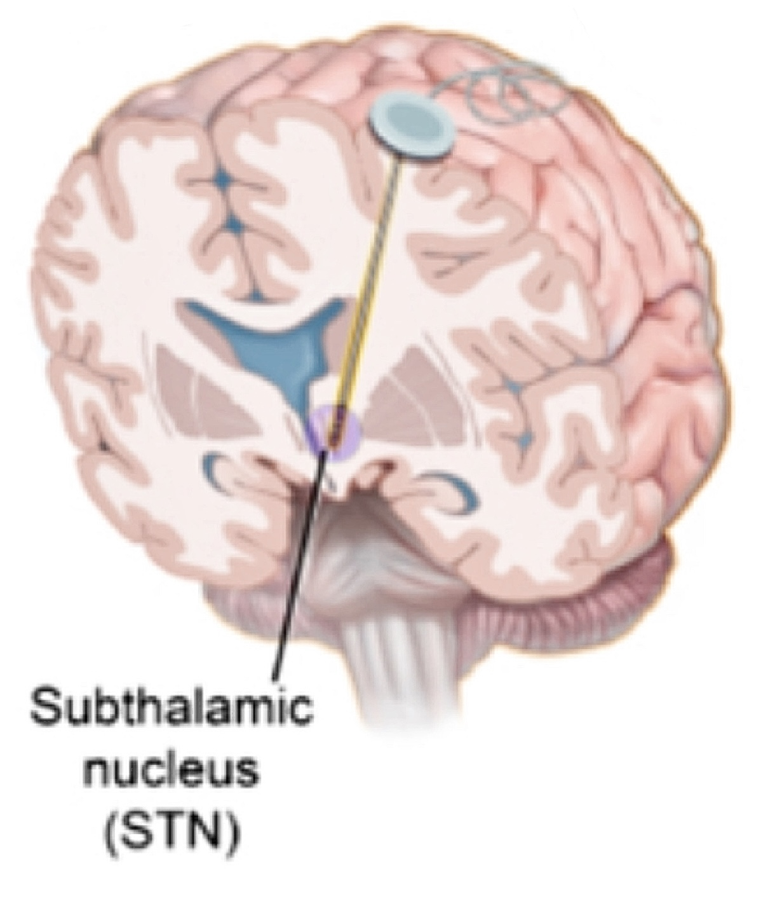
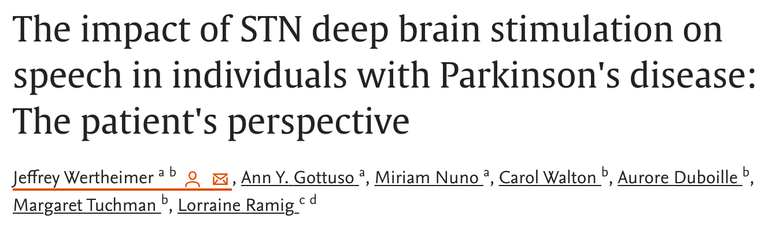
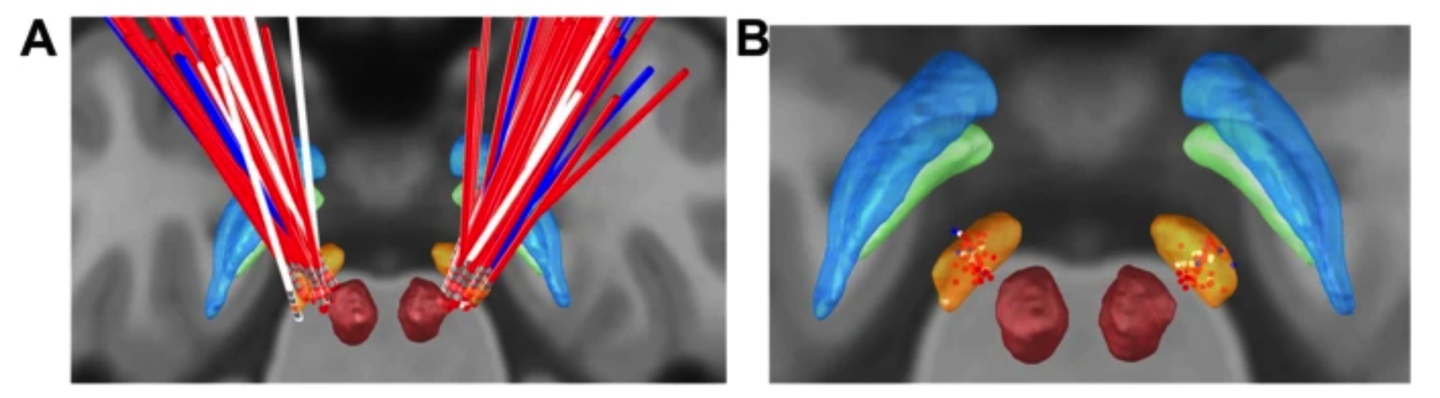
Deep Brain Stimulation of STN is the Common Parkinson’s Treatment
High-frequency deep brain stimulation of the STN (STN-HFS) substantially alleviates the electrophysiological and metabolic consequences of Parkinson’s Disease.
However, our current understanding lacks a detailed description of STN connectivity, and STN-HFS result varies based the precise placement of electrode.

Slide 6
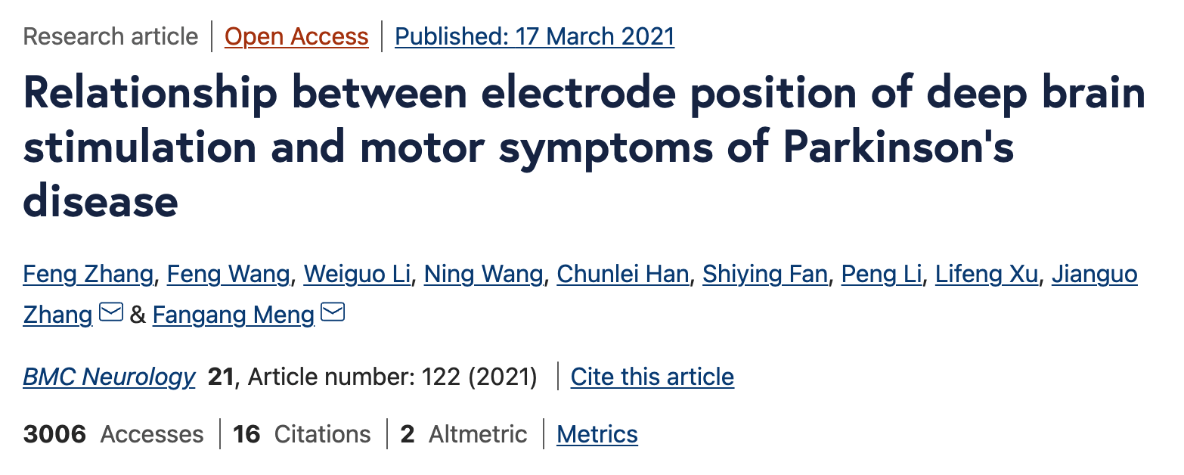
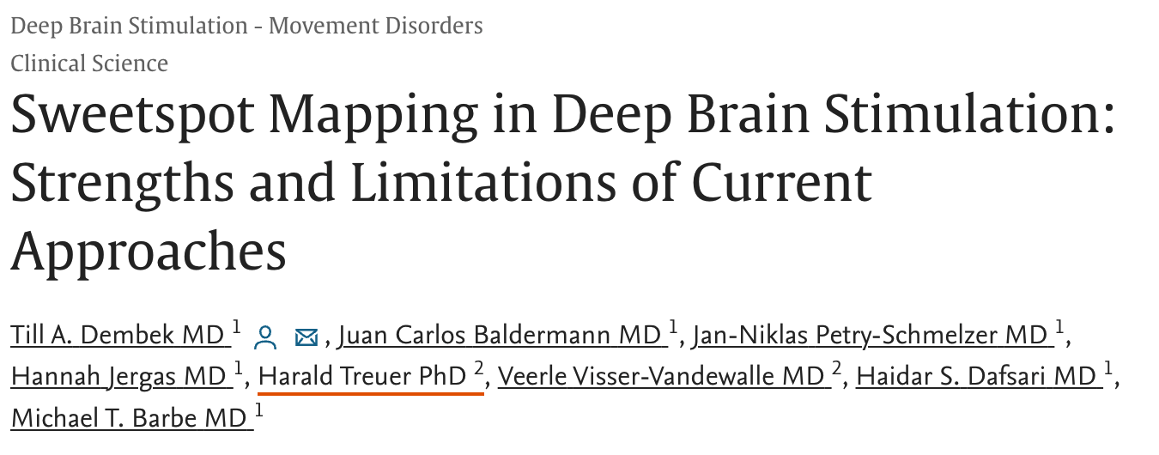
Deep Brain Stimulation Benefits from Understanding STN Connectivity
Due to lack of STN connectivity information, electrode implants are not guided and less precise. Suboptimal electrode placement has been shown to incur neurological conditions including dysarthria and hypophonia (Tsai et al.).
Several retrospective studies agreed that electrode placement in dorsal lateral STN score higher clinical assessment scales in Parkinson patients, but why (Zhang et al. , Dembek et al.)?

Slide 7
02
Methods

Slide 8

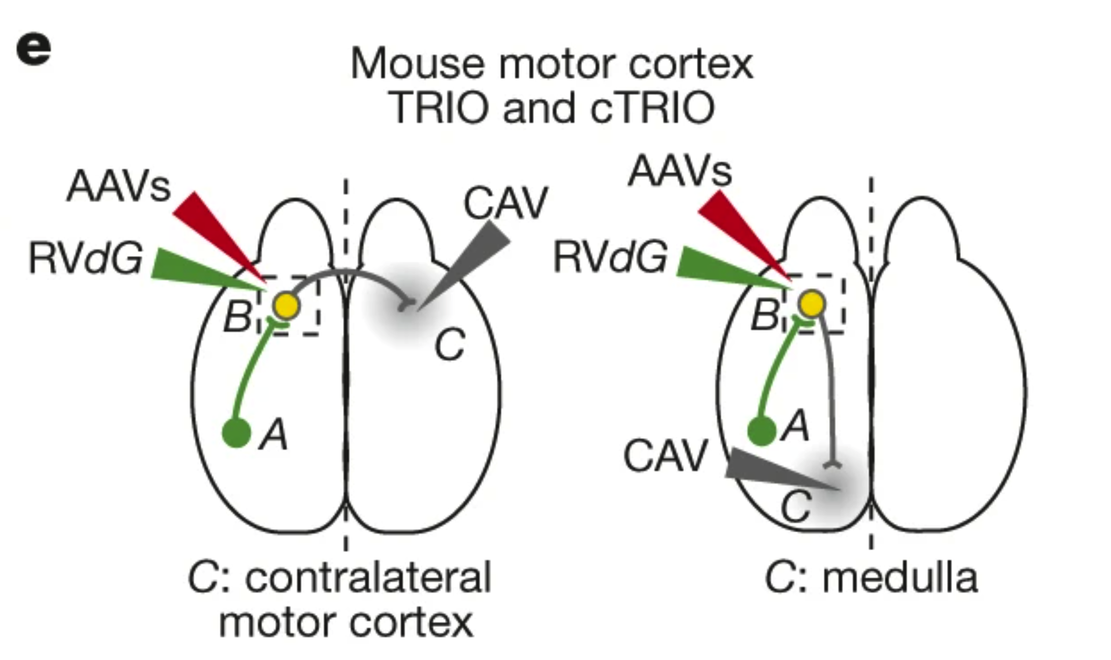
TRIO Tracing Provides Better Specificity than Conventional Methods
TRIO is short for “tracing the relationship between input and output”, a virus tracing construct introduced by Lindsay et.al.
TRIO enables trans-synaptic input tracing from specific subsets of neurons based on their projection and cell type, which avoid false positive signal from injection leaks.
A Triple Injection Construct

Slide 9
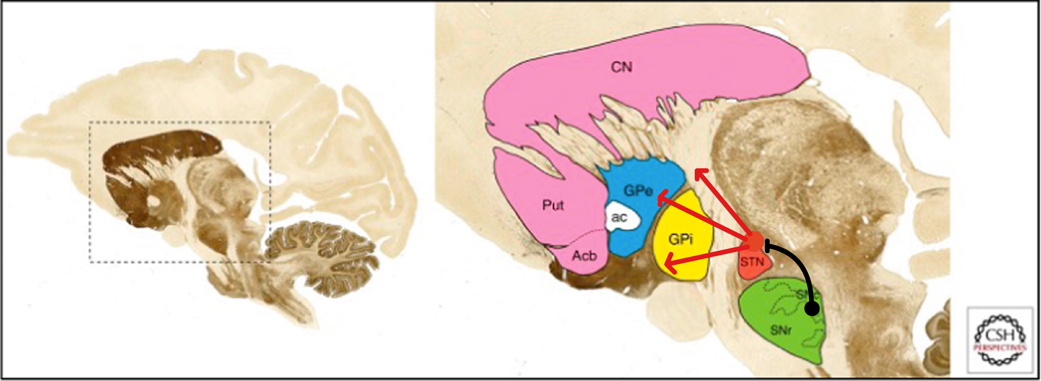
Our TRIO and cTRIO Construct
1. Retrograde expression of Cre Recombinase: AAVretro-hSyn-Cre-WPRE (AAV1)
2. Expression of TVA Viral Receptor and GFP: AAV8-hSyn-FLEX-TVA-P2A-GFP-P2A-oG (AAV2)
3. Retrograde expression of rabies virus with mCherry reporter gene: EnvA-G-deleted-RV-mCherry (R1)
EnvA-G-deleted-RV-mCherry
AAV8-hSyn-FLEX-TVA-P2A-GFP-P2A-oG
AAVretro-hSyn-Cre-WPRE
Alternatively PV-Cre

Slide 10
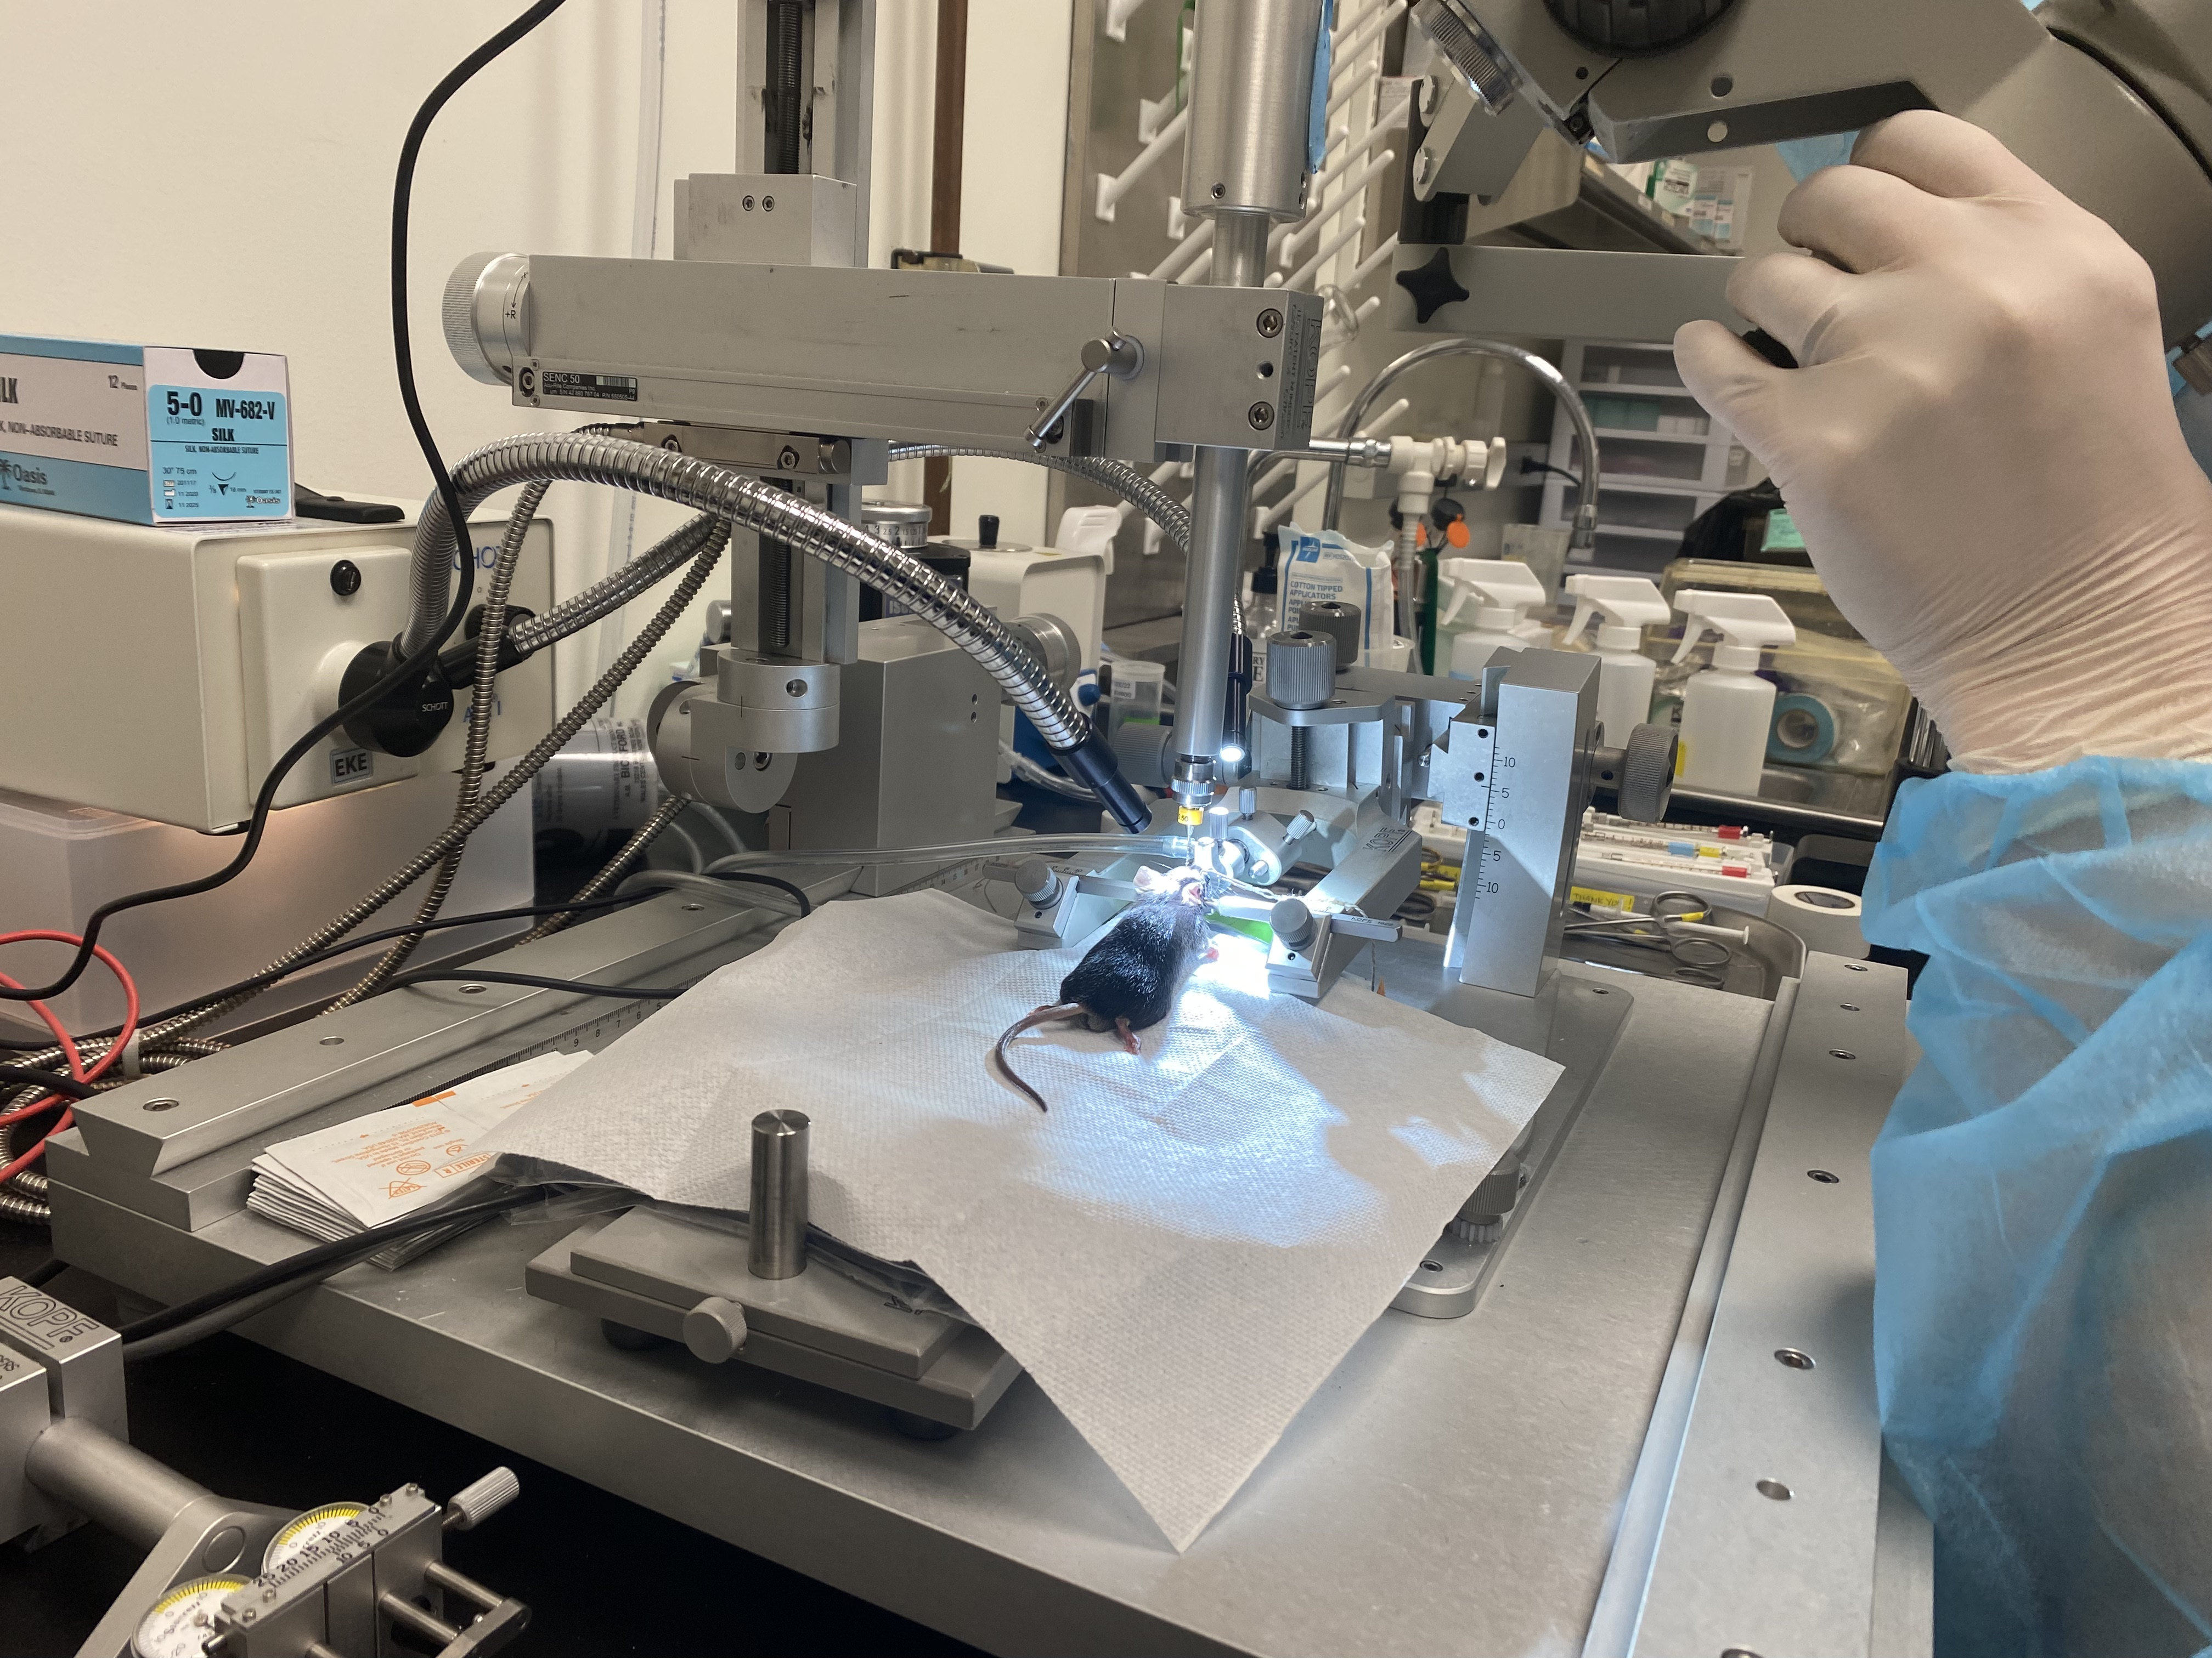
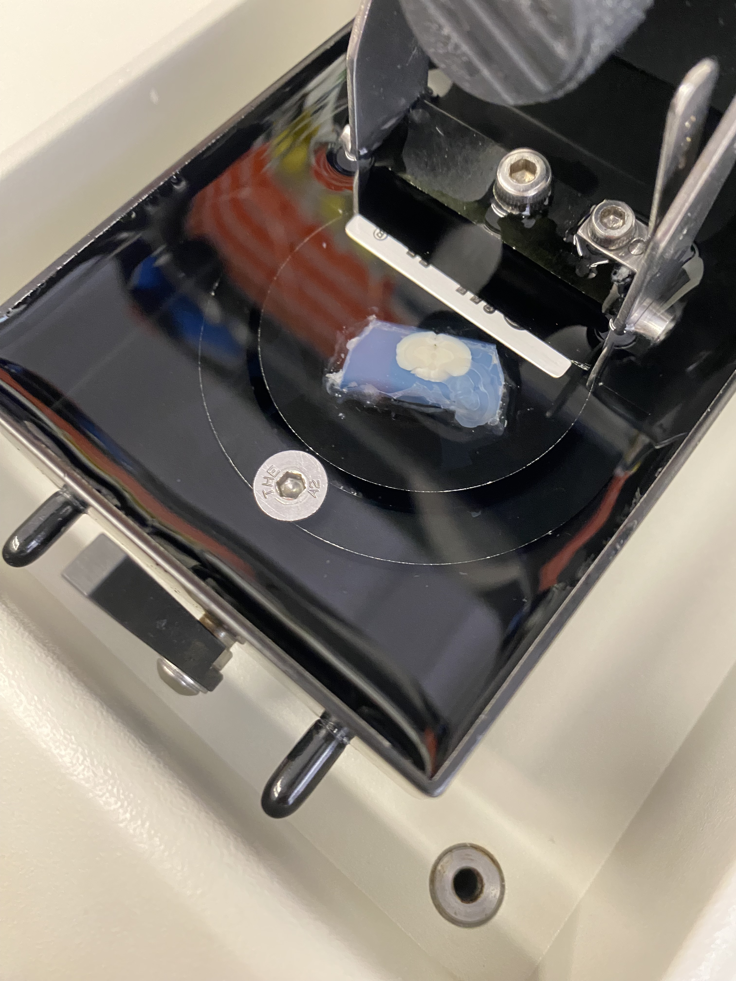
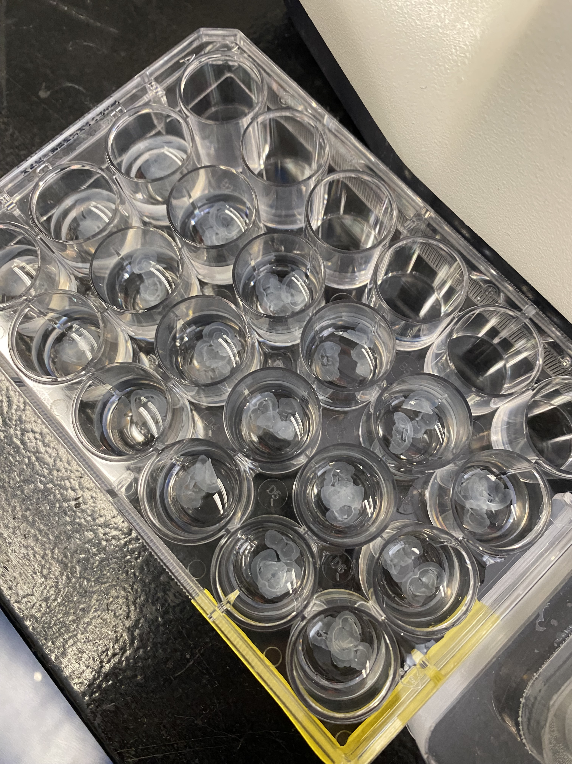
Tissue Analysis: Vibratome and Slide Scan
Mice were bred for 7 days after surgery to allow for viral protein expression. After perfusion with PFA, brain tissues were sliced at 100 micrometers with a vibratome and then scanned with fluorescent slidescans (Olympus VS200).

Slide 11
03
Results

Slide 12
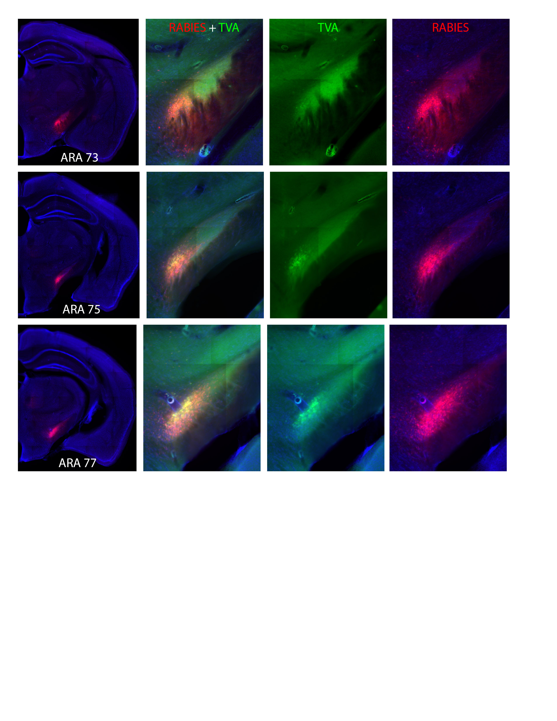
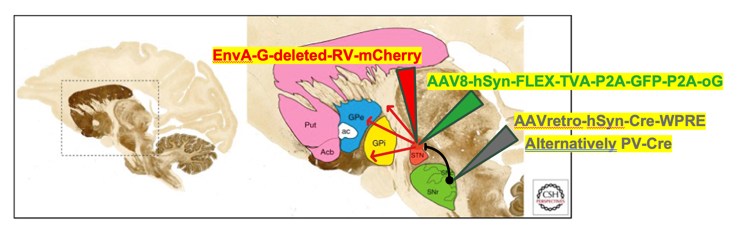
Injection Site Analysis
Fluorescent signals from rabies and TVA confirmed the successful implementation of the construct.
RABIES + TVA
TVA
RABIES
RABIES + TVA
TVA
RABIES

Slide 13
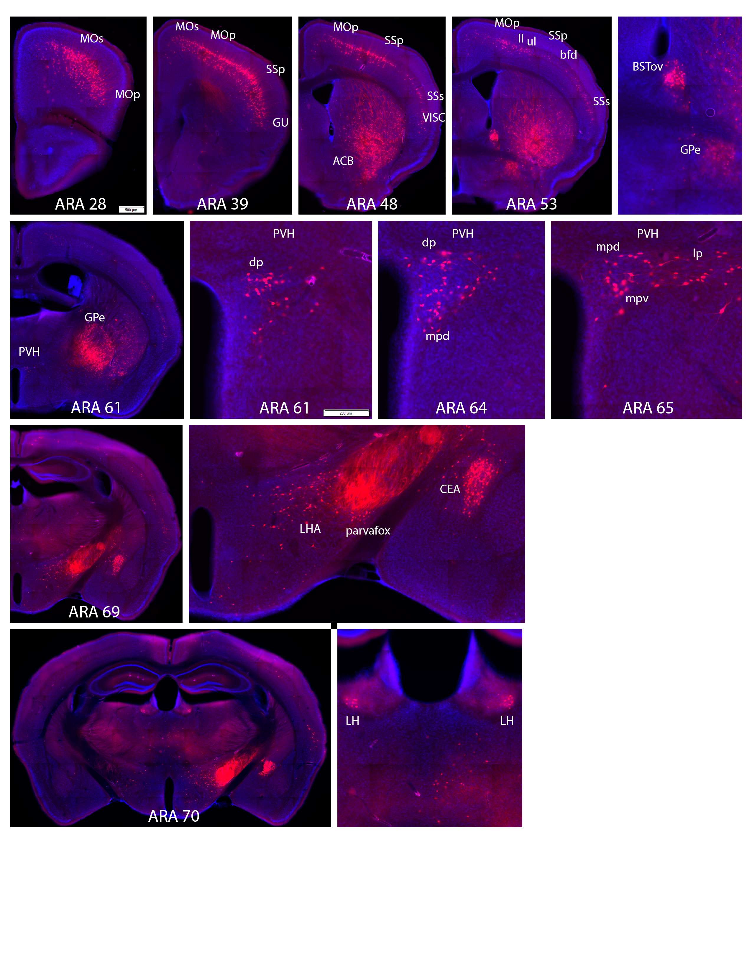
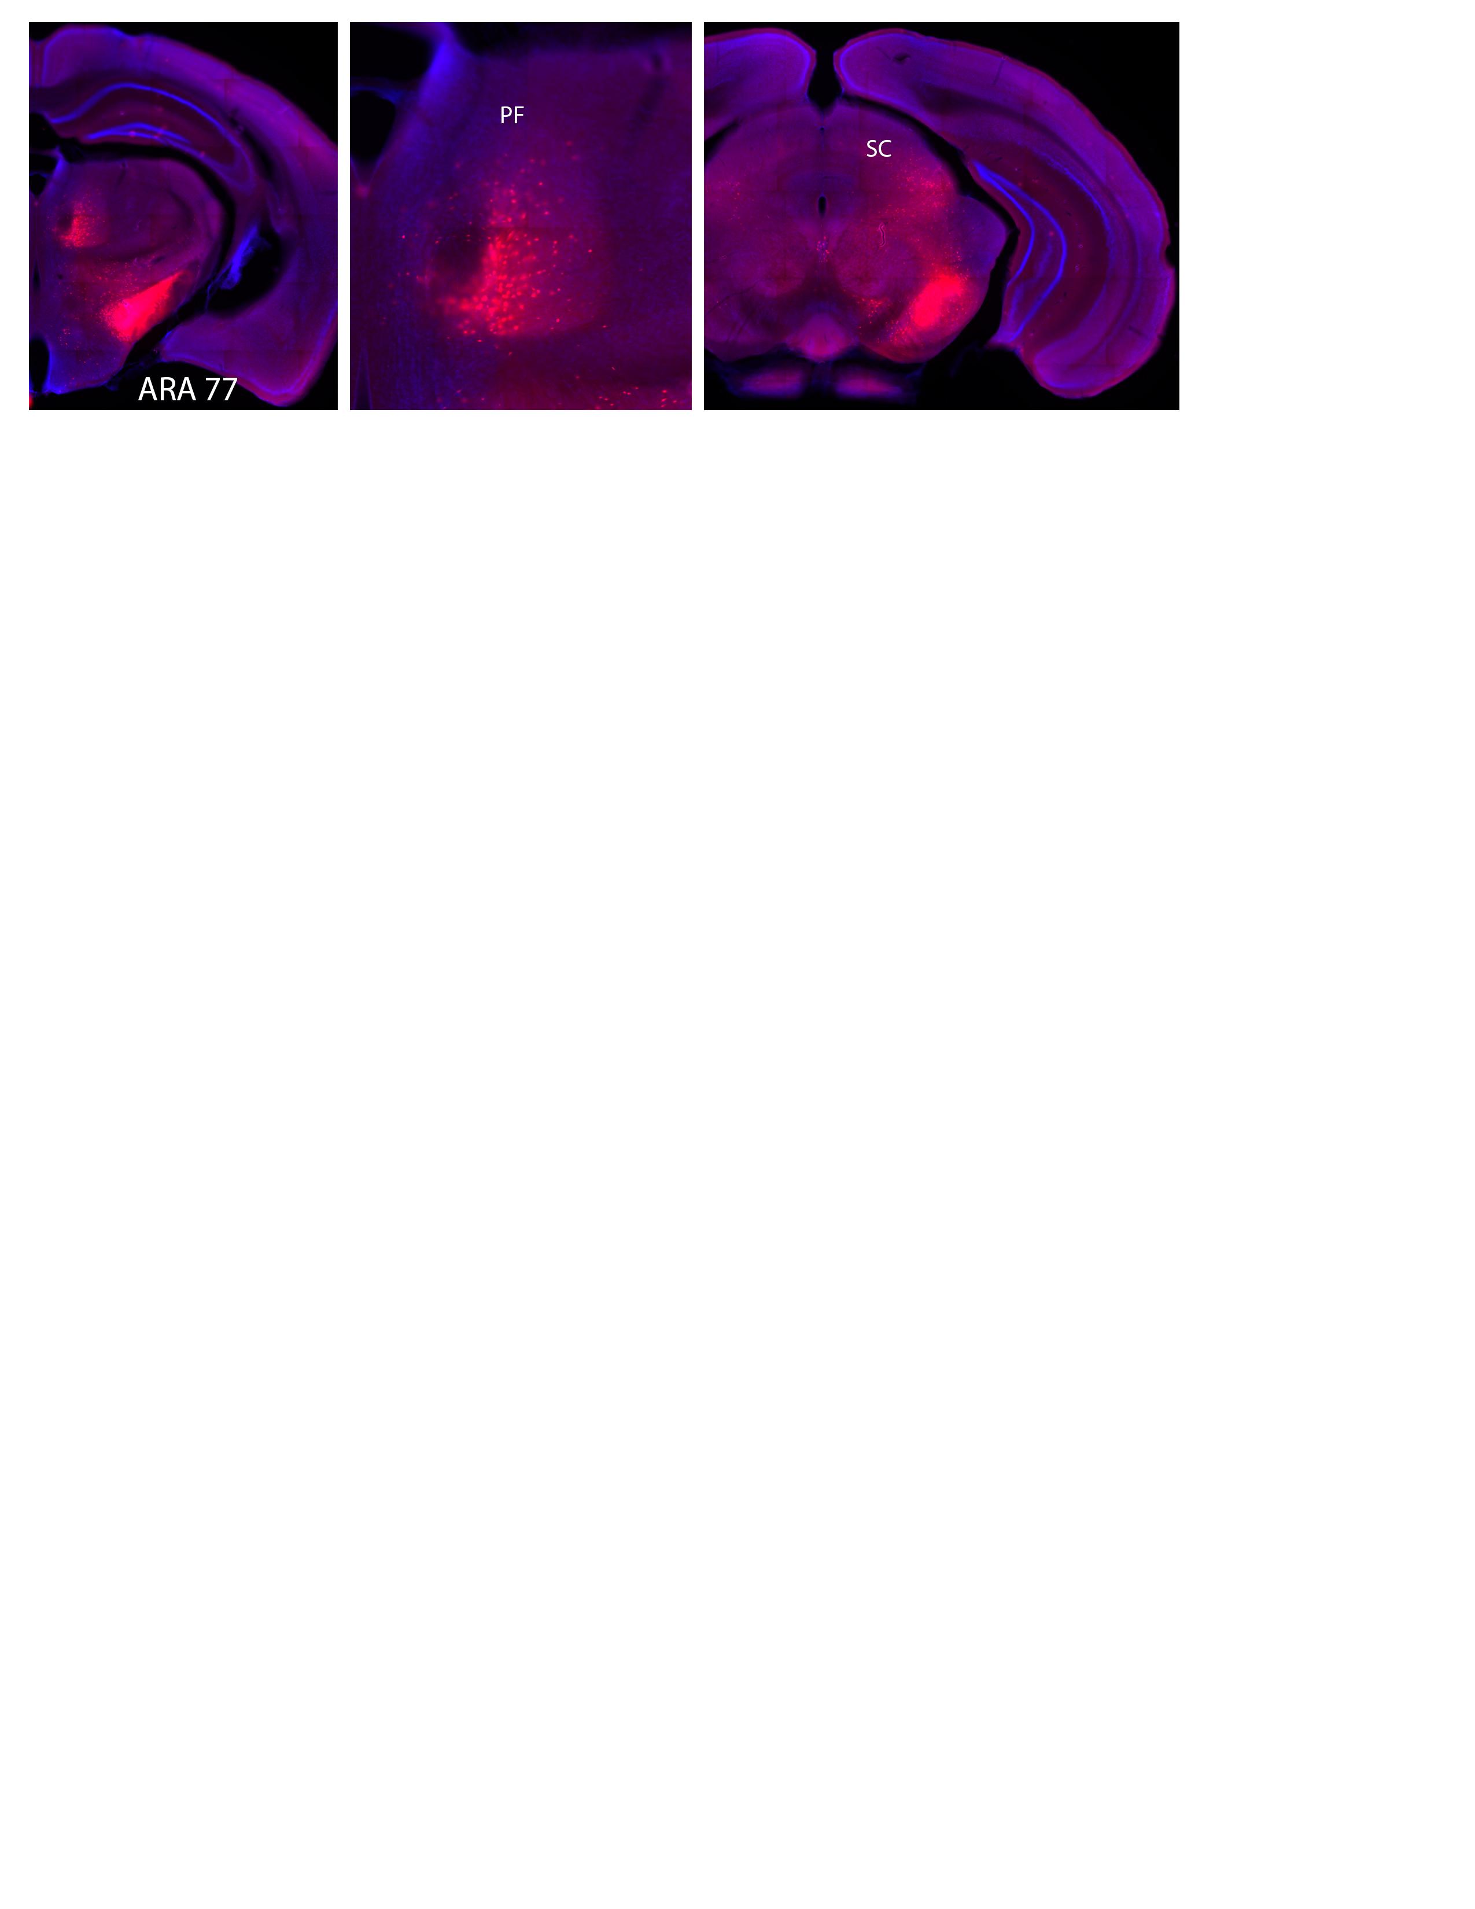
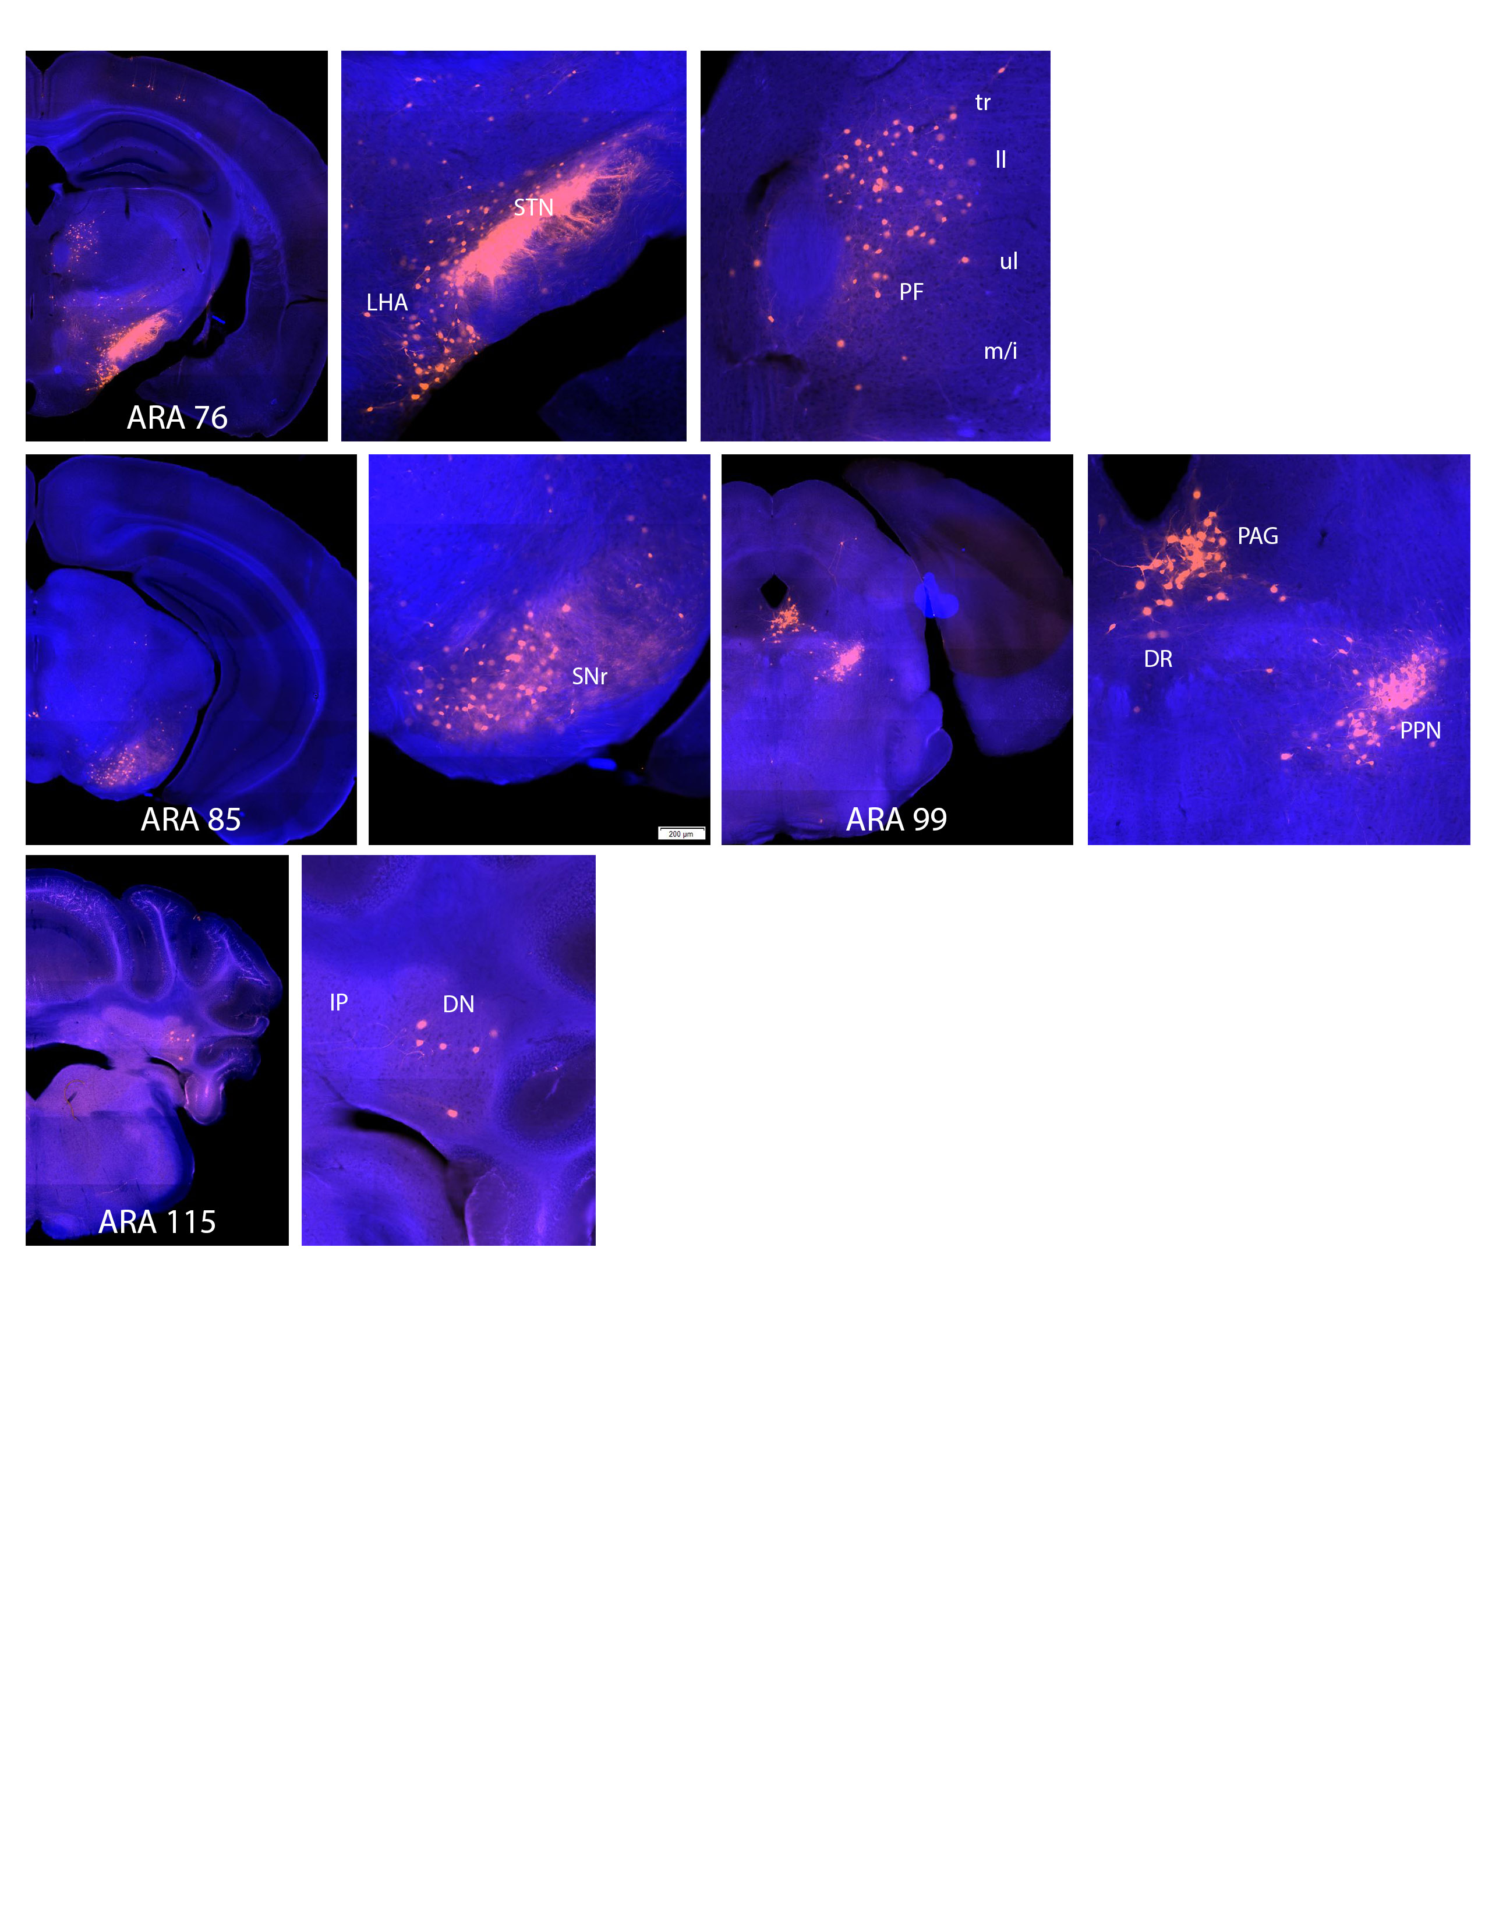
Confirmation of Afferent Structures from Previous Literature
Confirmed both existing and suspected afferent structures, along with newly identified regions.
ARA 88
Notes:
PF: Parafascicular Nucleus
SC: Superior Colliculus
MOs: Sensory Motor Area
MOp: Primary Motor Area
SSp: Primary Somatosensory Area
Gu: Gustatory Area
SSs: Supplementary Somatosensory Area
VISC: Visceral Area
LHA: Lateral Hypothalamic Area
CEA: Central Amygdalar Nucleus
LH: Lateral Hebenula
DN: Dentate Nucleus
PAG: Periaduaductal Grey
DR: Dorsal Nucleus Raphe
PPN: Pedunculopontine Nucleus
IP: Interposed Nucleus

Slide 14
Evidence for Afferent Connection from Caudoputamen
Identified intense afferent connections that the STN receives from Caudoputamen not reported in previous literature.

Slide 15
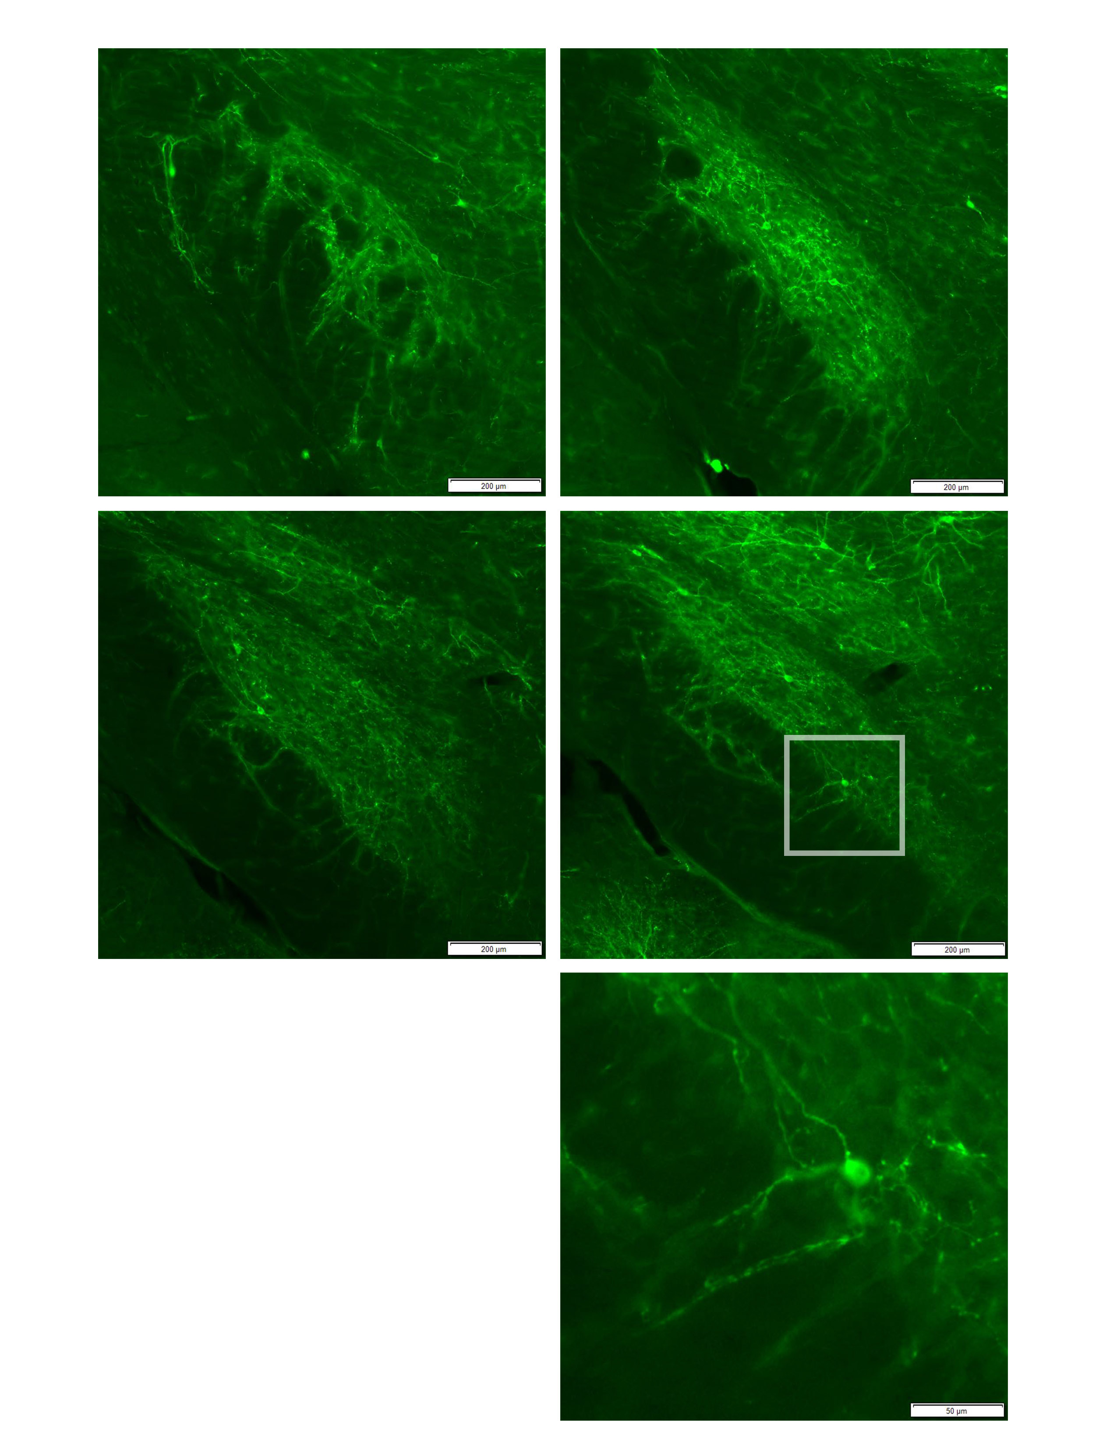
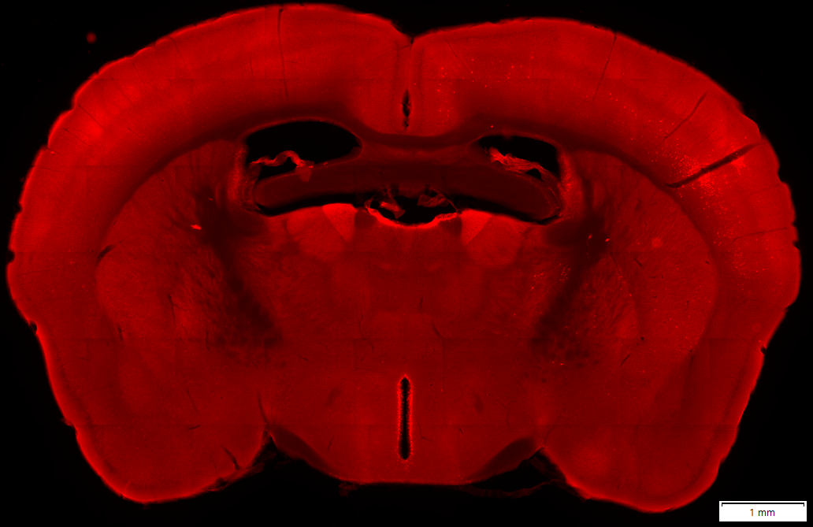
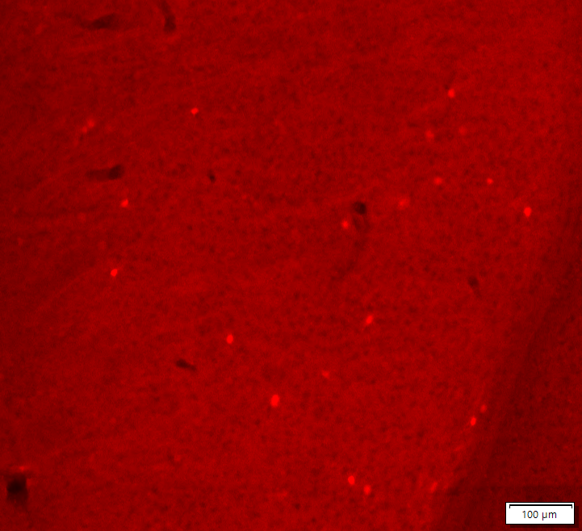
Identifying the Organization of Caudoputamen
Follow-up experiment using cTRIO protocol confirmed sparse labeling in CP.
ARA 61
PV-MORF
cTRIO Afferent Labeling

Slide 16
04
Discussion

Slide 17
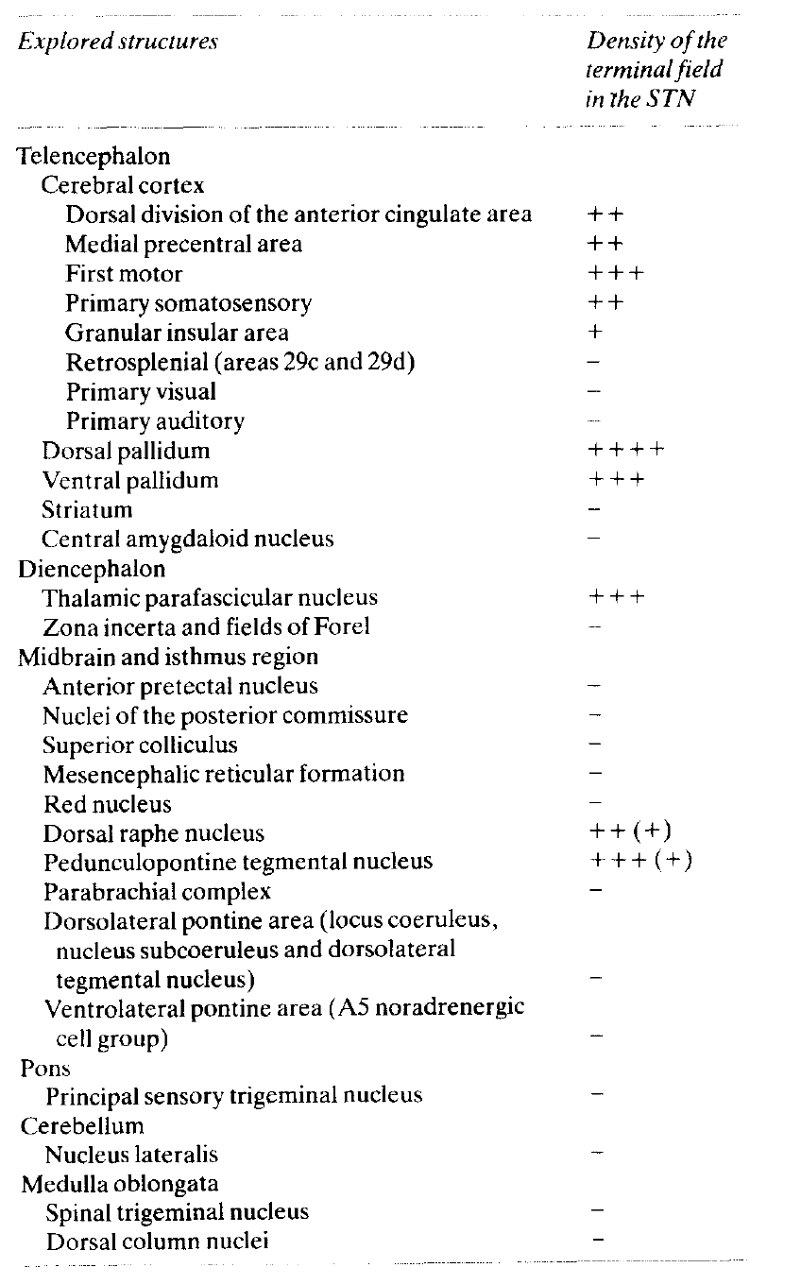
Reinforcing Established Afferent Structures
Reinforced Established Structures
Notes:
PF: Parafascicular Nucleus
SC: Superior Colliculus
MOs: Sensory Motor Area
MOp: Primary Motor Area
SSp: Primary Somatosensory Area
Gu: Gustatory Area
SSs: Supplementary Somatosensory Area
VISC: Visceral Area
LHA: Lateral Hypothalamic Area
CEA: Central Amygdalar Nucleus
LH: Lateral Hebenula
DN: Dentate Nucleus
PAG: Periaduaductal Grey
DR: Dorsal Nucleus Raphe
PPN: Pedunculopontine Nucleus
IP: Interposed Nucleus

Slide 18
Confirming Less Established and Unknown Afferent Structures
ARA 88
Less Established Structures
ARA 70
Unknown Structures
Notes:
PF: Parafascicular Nucleus
SC: Superior Colliculus
MOs: Sensory Motor Area
MOp: Primary Motor Area
SSp: Primary Somatosensory Area
Gu: Gustatory Area
SSs: Supplementary Somatosensory Area
VISC: Visceral Area
LHA: Lateral Hypothalamic Area
CEA: Central Amygdalar Nucleus
LH: Lateral Hebenula
DN: Dentate Nucleus
PAG: Periaduaductal Grey
DR: Dorsal Nucleus Raphe
PPN: Pedunculopontine Nucleus
IP: Interposed Nucleus

Slide 19
Evidence for Internal Organization in Globus Pallidus External Segment
Afferent innervations to STN concentrates to the ventral medial region of the Globus Pallidus external segment (GPe), another popular deep brain stimulation target, providing evidence for an internal projection organization of GPe tissue.
ARA 88

Slide 20
Identifying the Organization of Caudoputamen
Follow-up experiment using cTRIO confirms labeling in CP, which appears sparsely. This indicates that the target STN neurons projecting to SNr only sparsely coincide with PV-expressing STN neurons.
STN Neurons Projecting to SNr
STN with the PV Promoter
ARA 61
Overlaping STN Neurons: Labeling in cTRIO
ARA 61
TRIO Afferent Labeling
cTRIO Afferent Labeling

Slide 21
05
References

Slide 22
Major References
Wertheimer, Jeffrey, et al. "The impact of STN deep brain stimulation on speech in individuals with Parkinson's disease: the patient's perspective." Parkinsonism & related disorders 20.10 (2014): 1065-1070.
Zhang, Feng, et al. "Relationship between electrode position of deep brain stimulation and motor symptoms of Parkinson’s disease." BMC neurology 21 (2021): 1-9.
Dembek, Till A., et al. "Sweetspot mapping in deep brain stimulation: strengths and limitations of current approaches." Neuromodulation: Technology at the Neural Interface 25.6 (2022): 877-887.
Canteras, Newton S., et al. "Afferent connections of the subthalamic nucleus: a combined retrograde and anterograde horseradish peroxidase study in the rat." Brain research 513.1 (1990): 43-59.
Robledo, Patricia, and Jean Féger. "Excitatory influence of rat subthalamic nucleus to substantia nigra pars reticulata and the pallidal complex: electrophysiological data." Brain research 518.1-2 (1990): 47-54.
Fazl, Arash, and Jori Fleisher. "Anatomy, physiology, and clinical syndromes of the basal ganglia: a brief review." Seminars in pediatric neurology. Vol. 25. WB Saunders, 2018.
Huang, Yonglu, et al. "Anatomical correlates of uncontrollable laughter with unilateral subthalamic deep brain stimulation in Parkinson’s disease." Frontiers in Neurology 9 (2018): 341.
Temel, Yasin, et al. "The functional role of the subthalamic nucleus in cognitive and limbic circuits." Progress in neurobiology 76.6 (2005): 393-413.
Tsai, Sheng-Tzung, et al. "Five-year clinical outcomes of local versus general anesthesia deep brain stimulation for Parkinson’s disease." Parkinson’s Disease 2019 (2019).

Slide 23
06
Acknowledgements

Slide 24
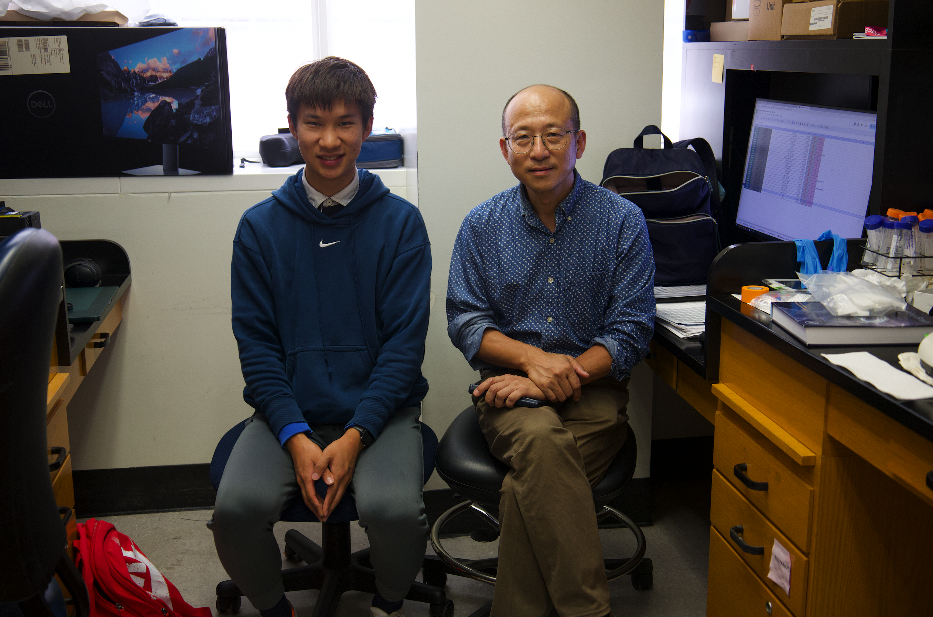
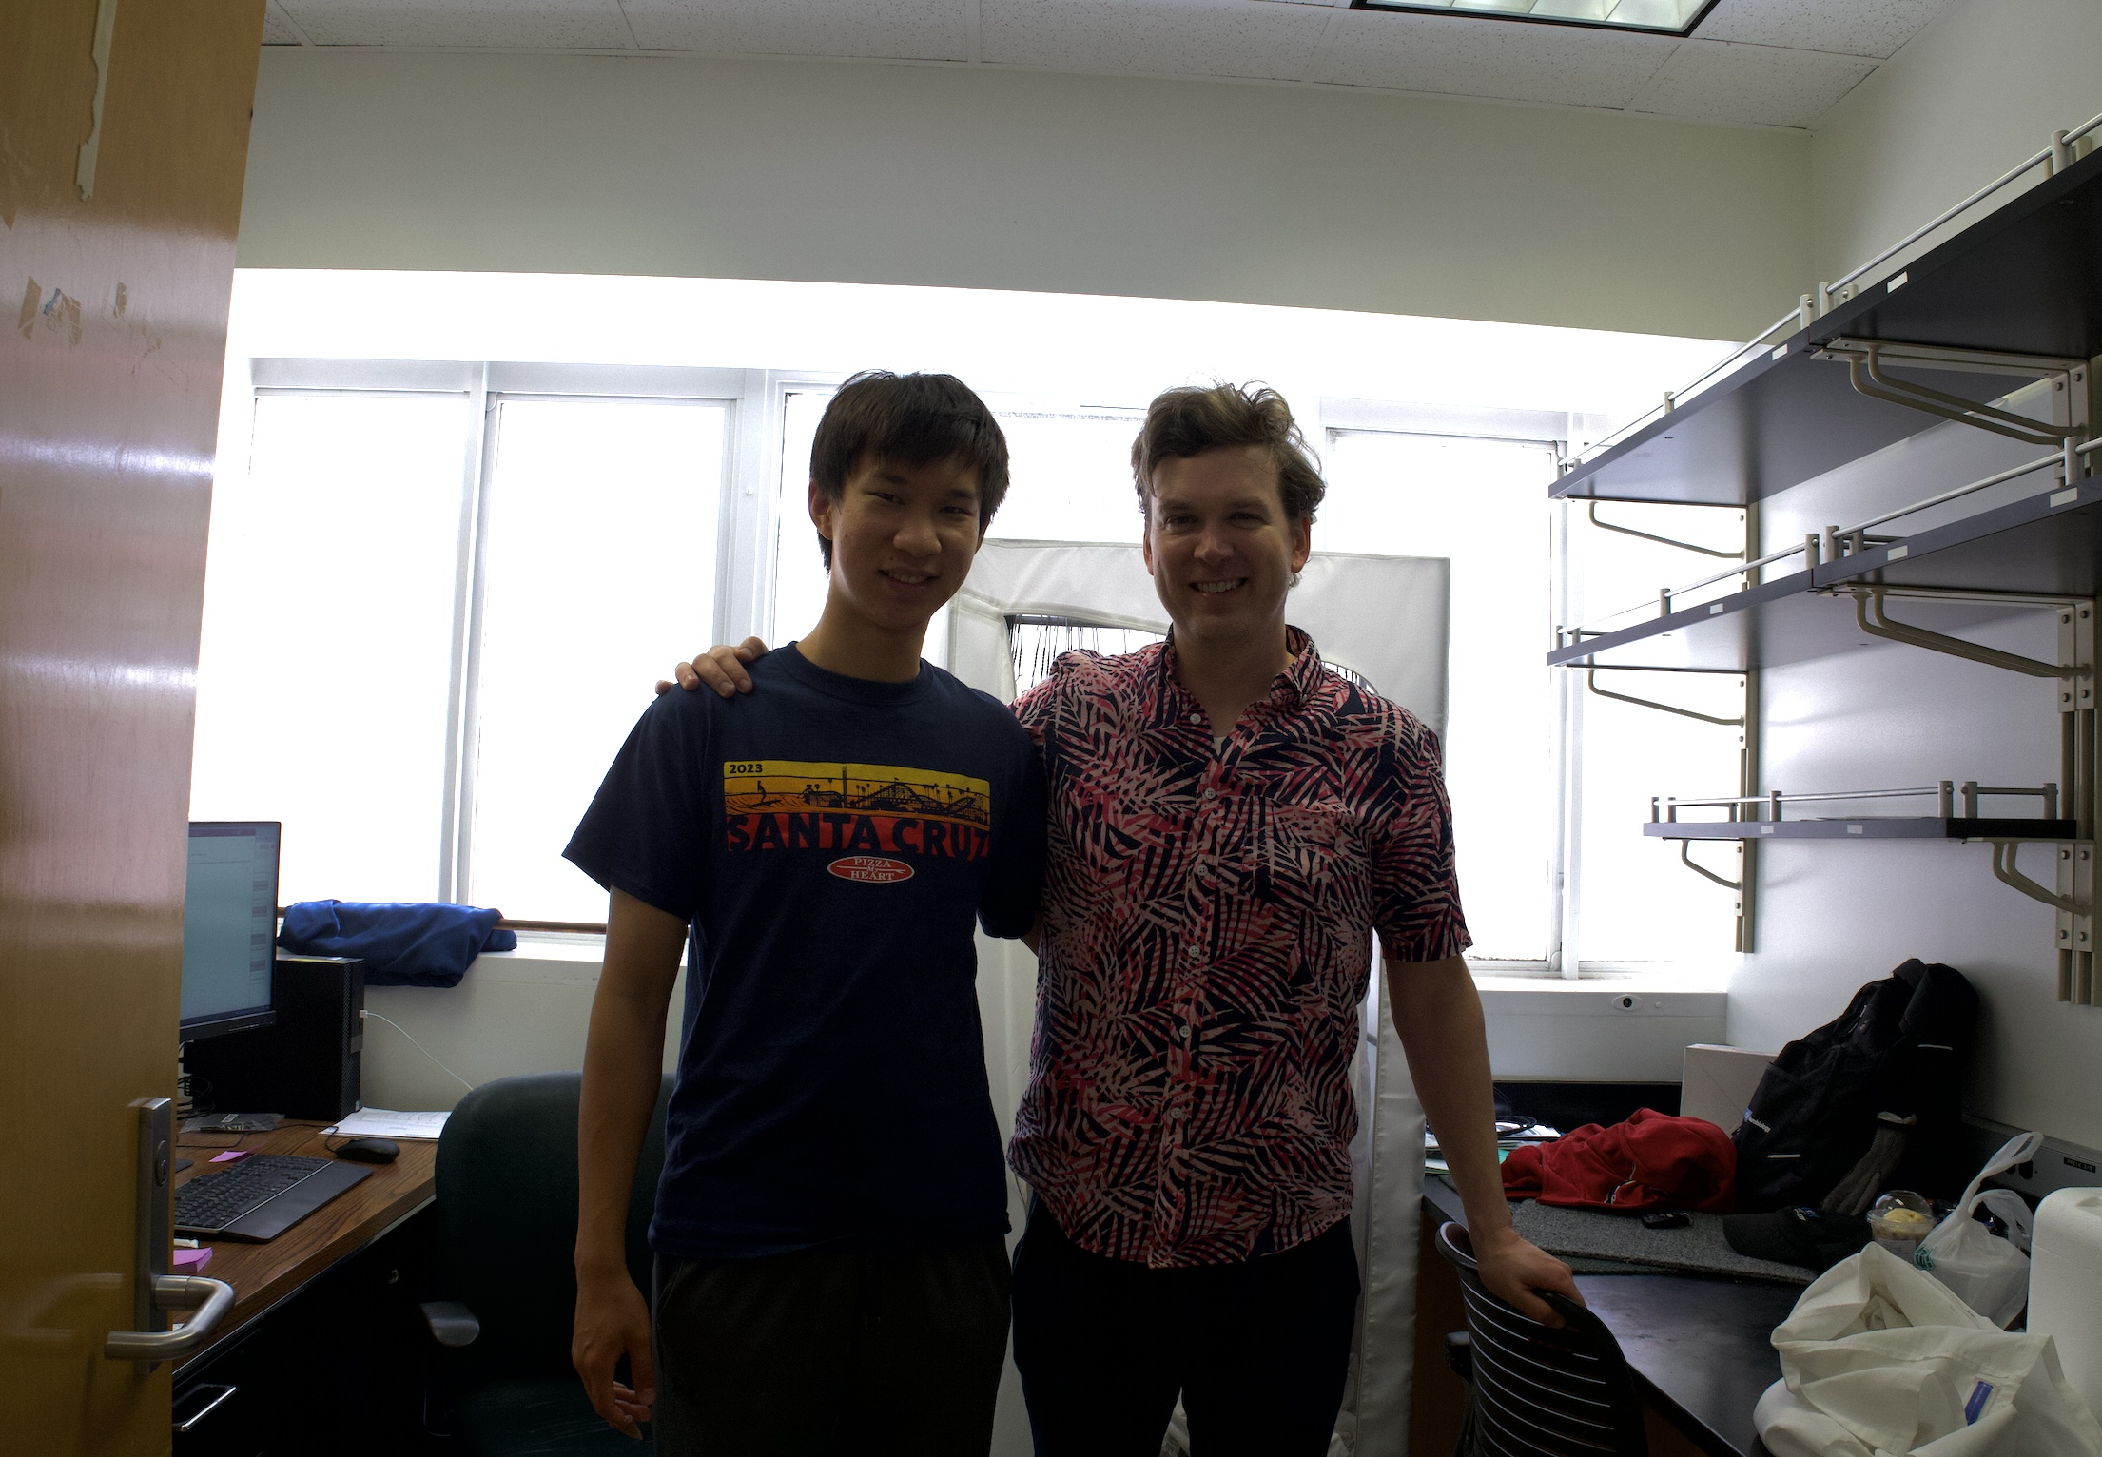
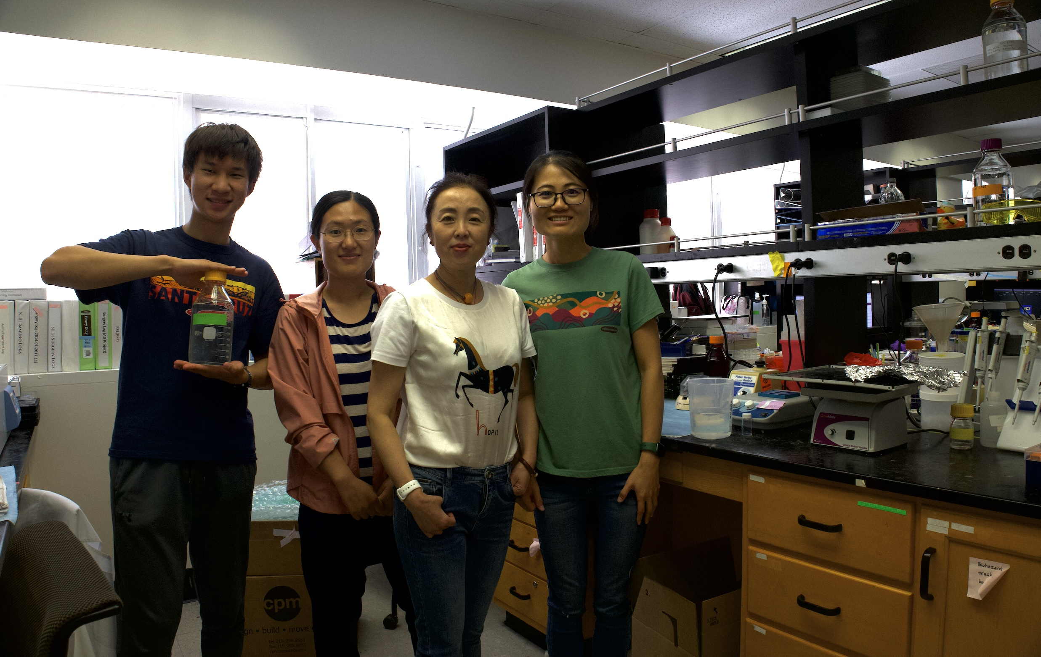
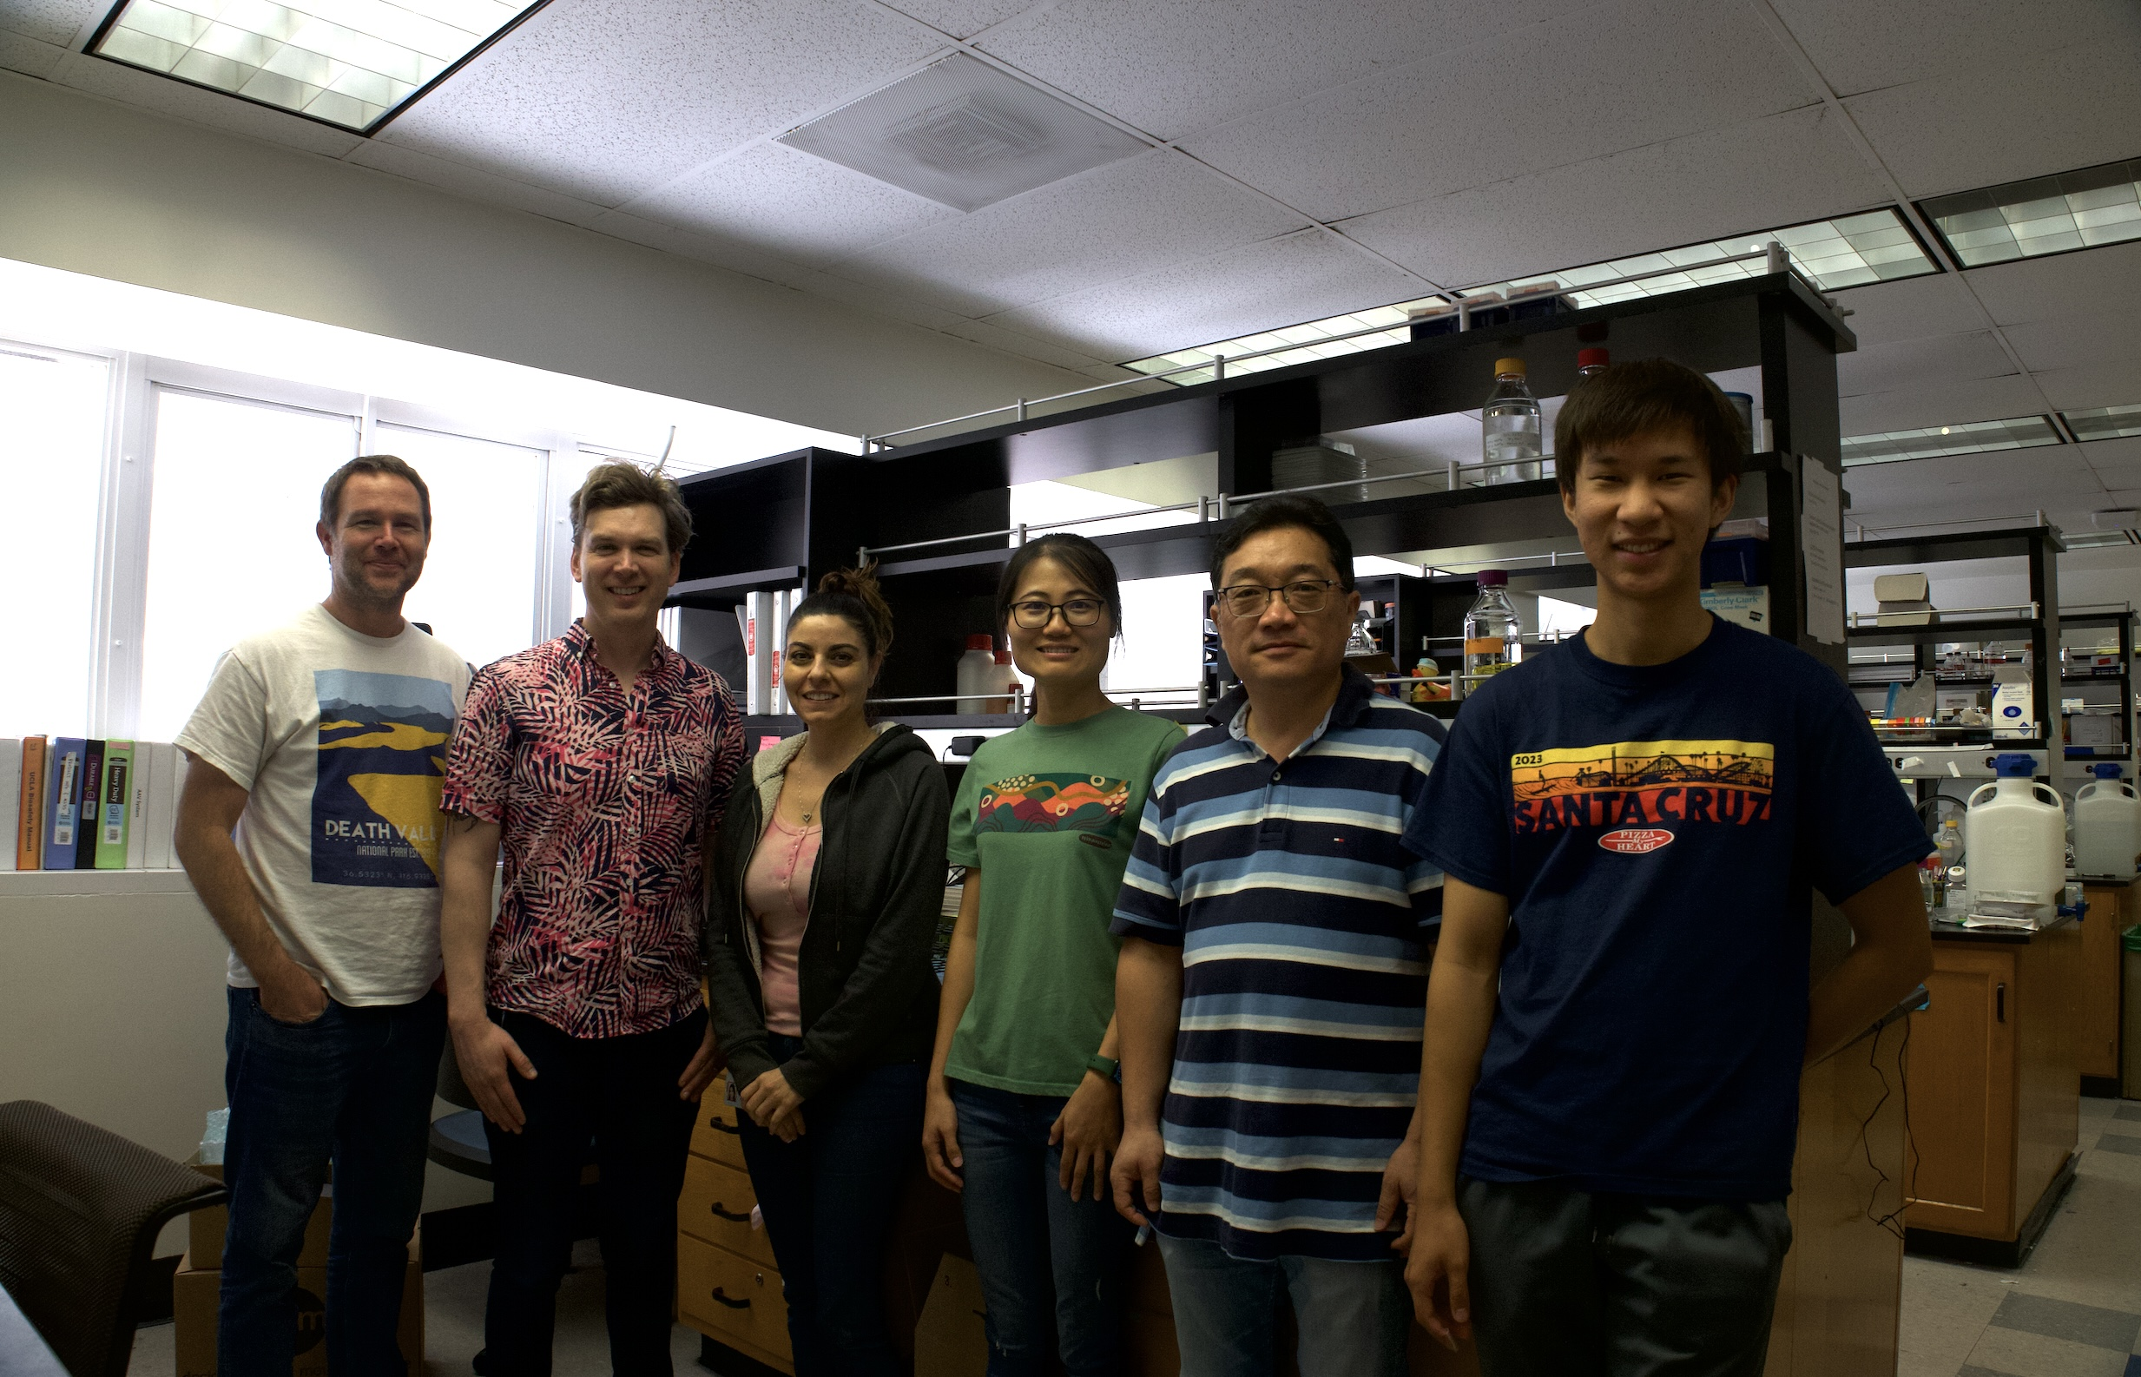
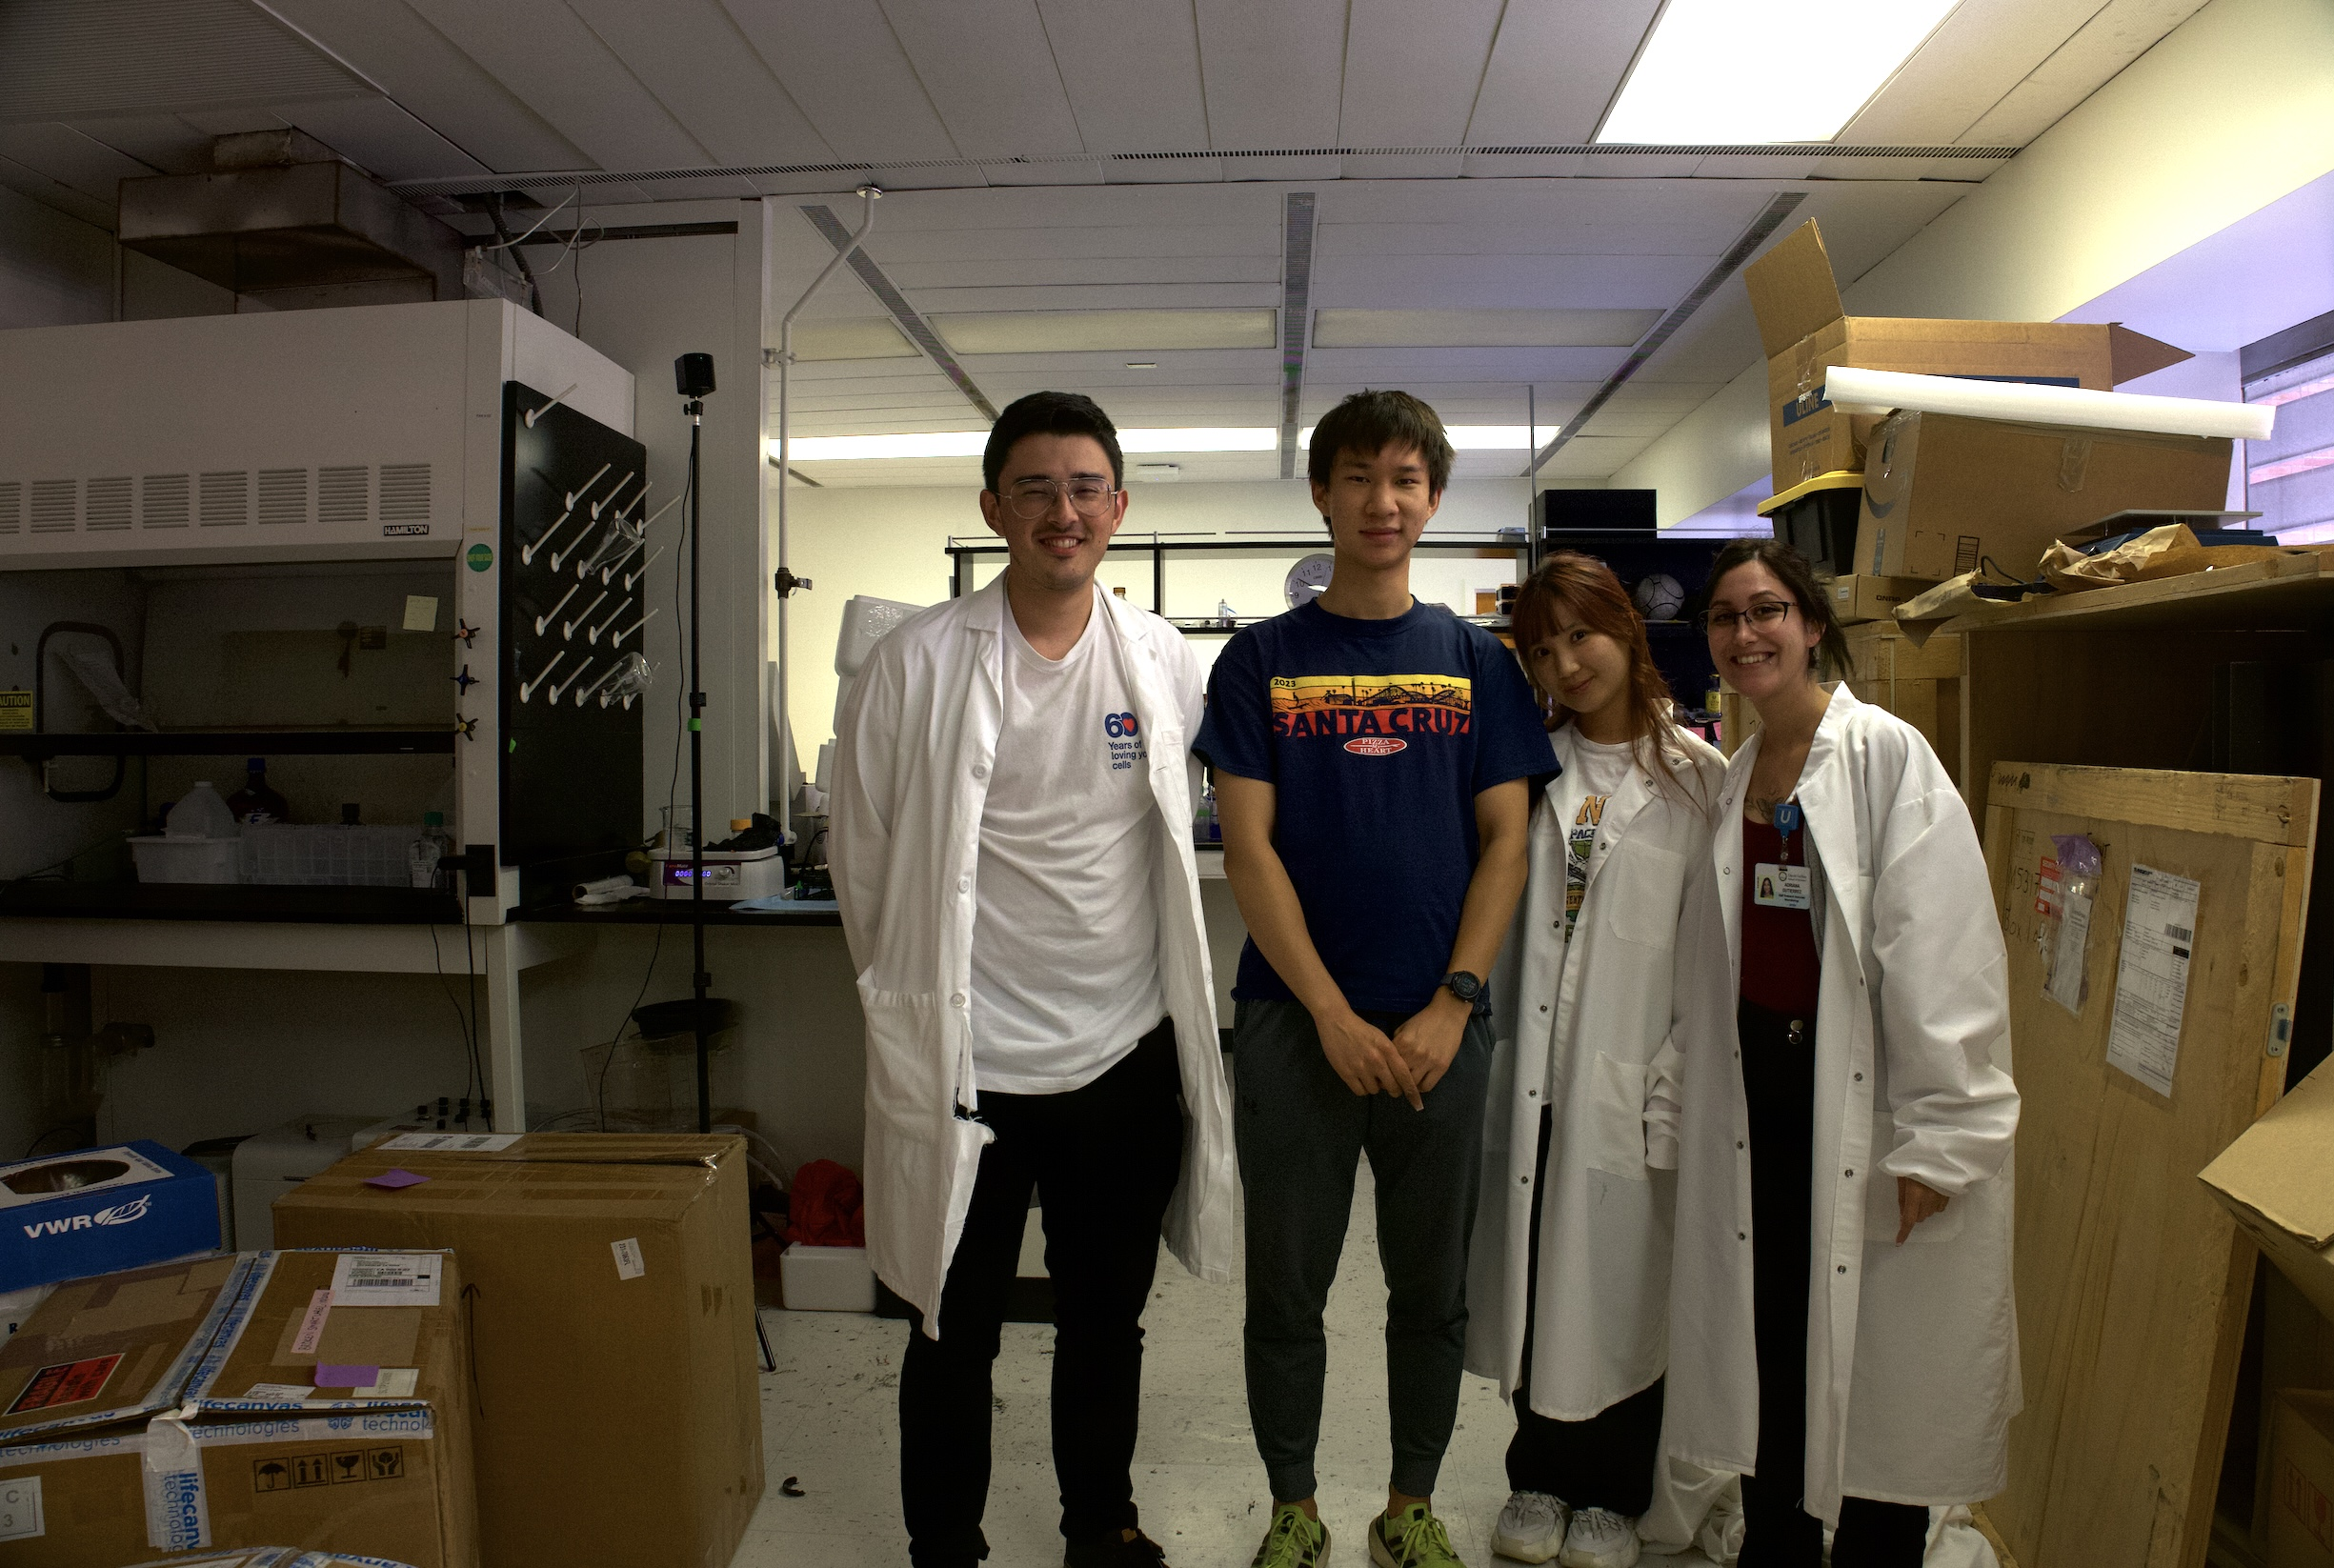
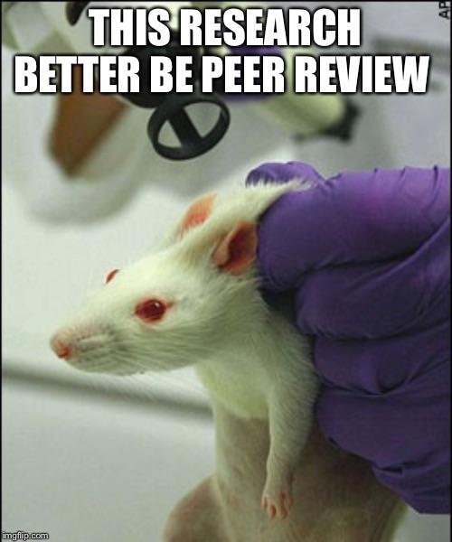
Dong Lab People

Slide 25




Fellow Neuroscholars

Slide 26
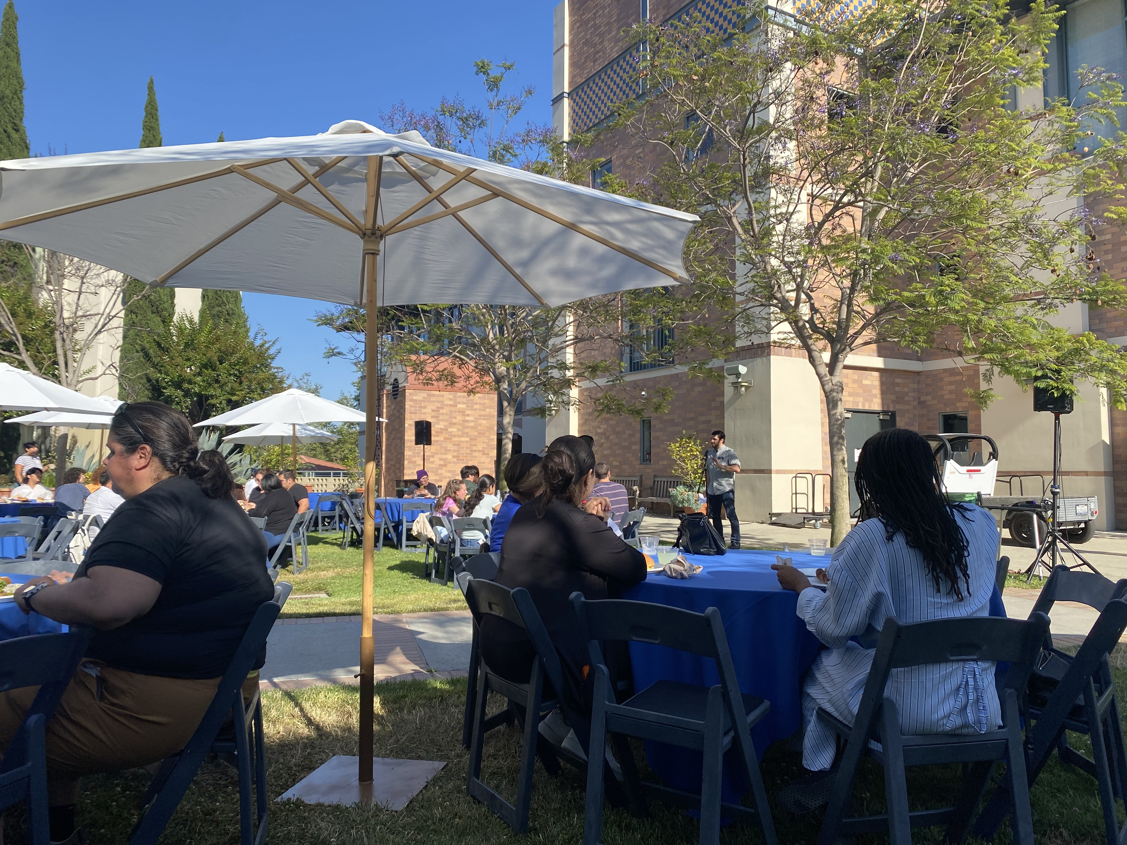

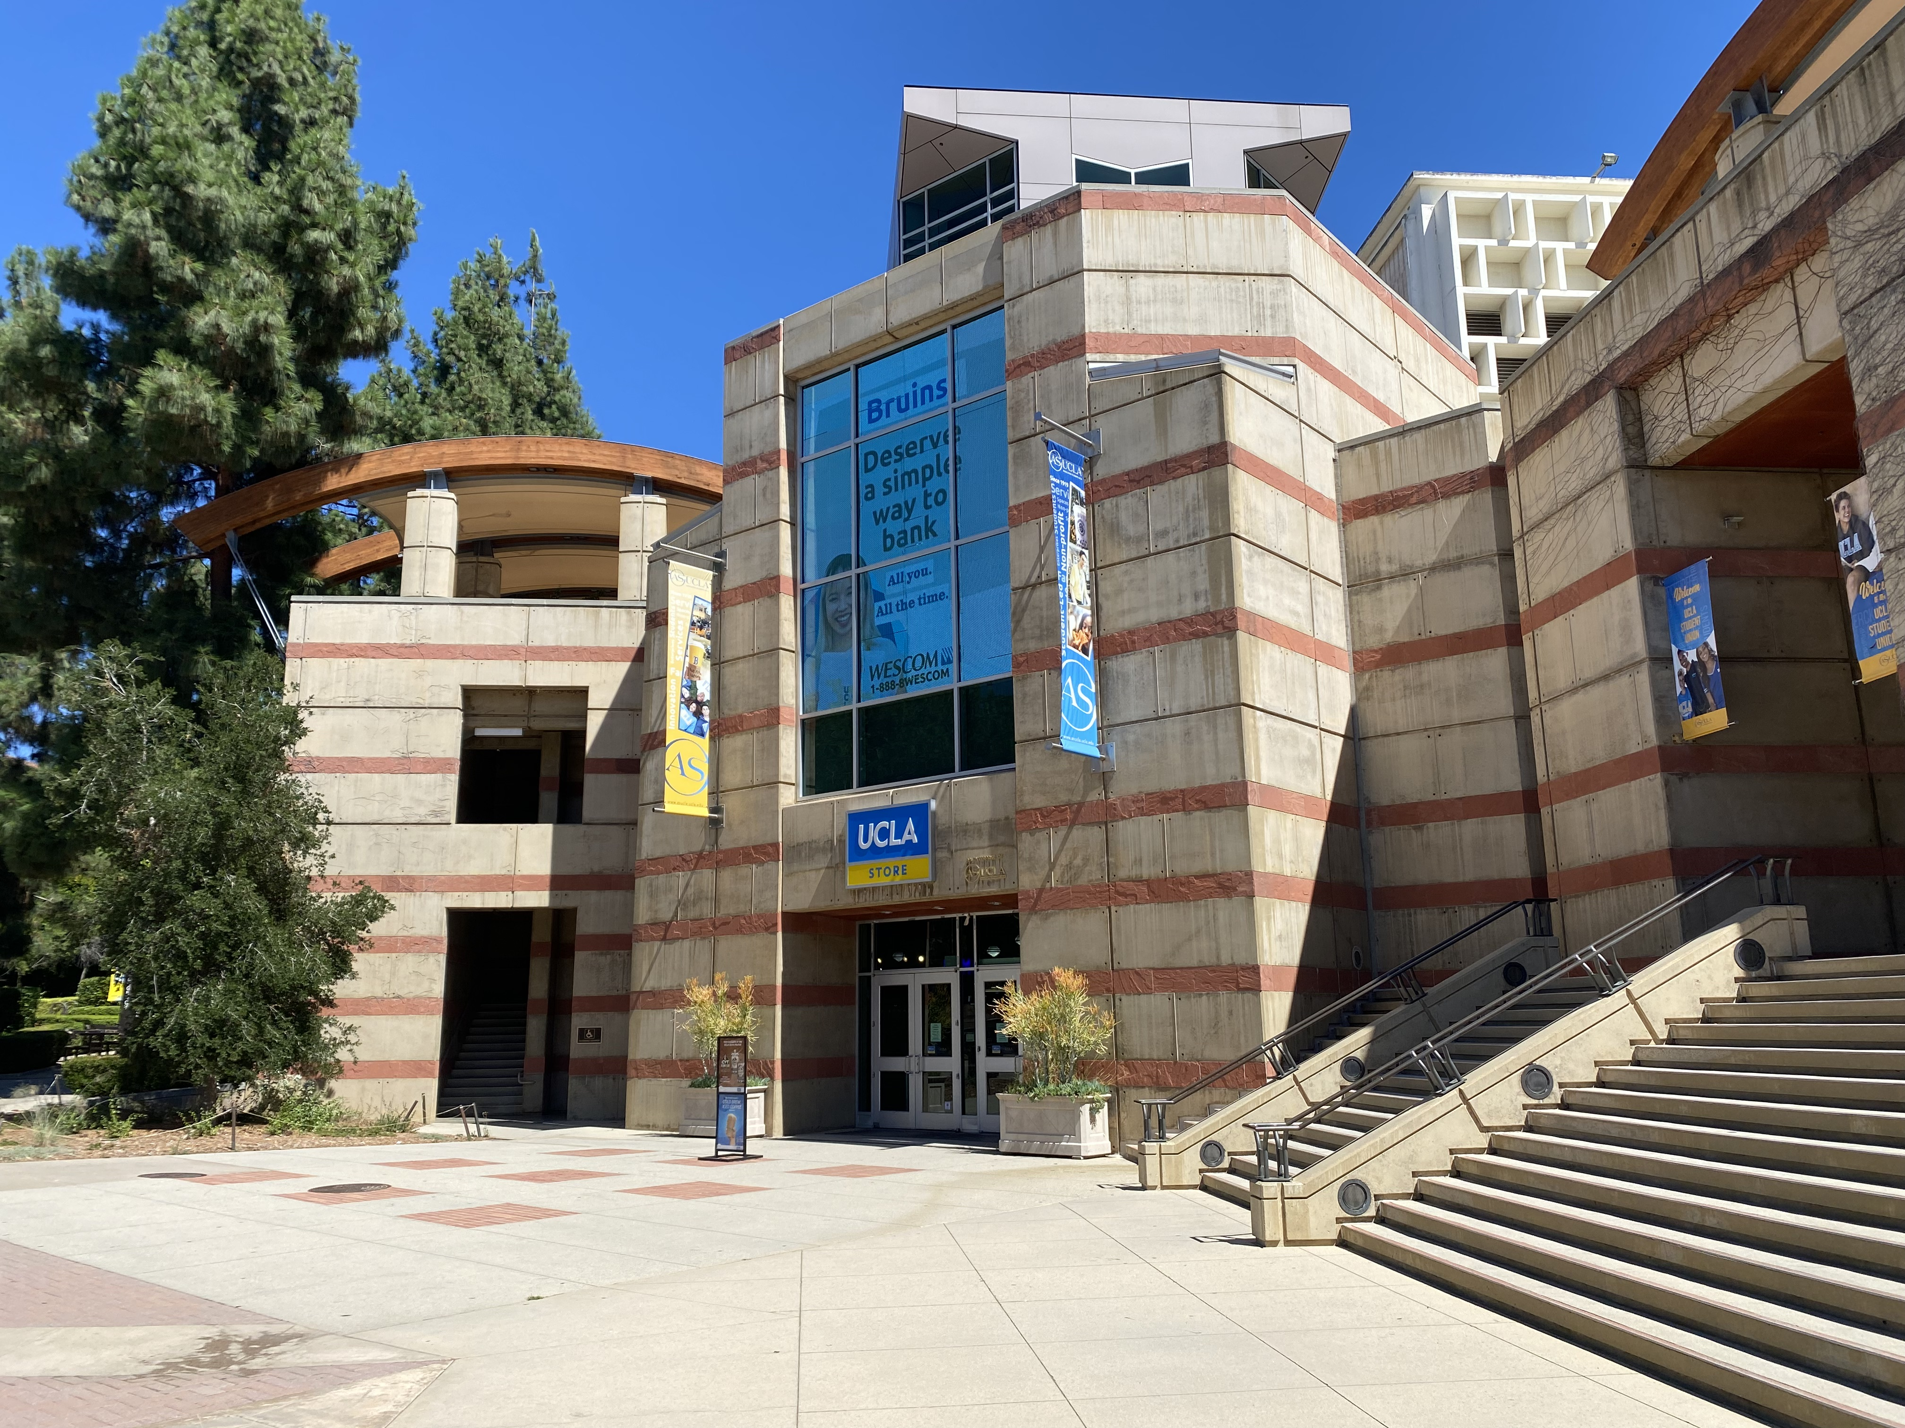

The Neuroscience Scholar Administration & UCLA

Slide 27
TRIO Analysis of Subthalamic Nucleus Afferent Connectivity
Thank You!
Lucas Wang, Nicholas Foster Hongwei Dong
Dong Lab at the UCLA
Neuroscience Scholar Program Summer 2023

